Slide 1







Climate Change Adaptation in the Detroit Region’s Urban Forest

Slide 2
Opening Remarks
Eric Candela, American Forests

Slide 3
Housekeeping
Please mute your speakers and turn off your cameras
Use the chat feature to ask questions
Please “rename” yourself with your name, affiliation

Slide 4
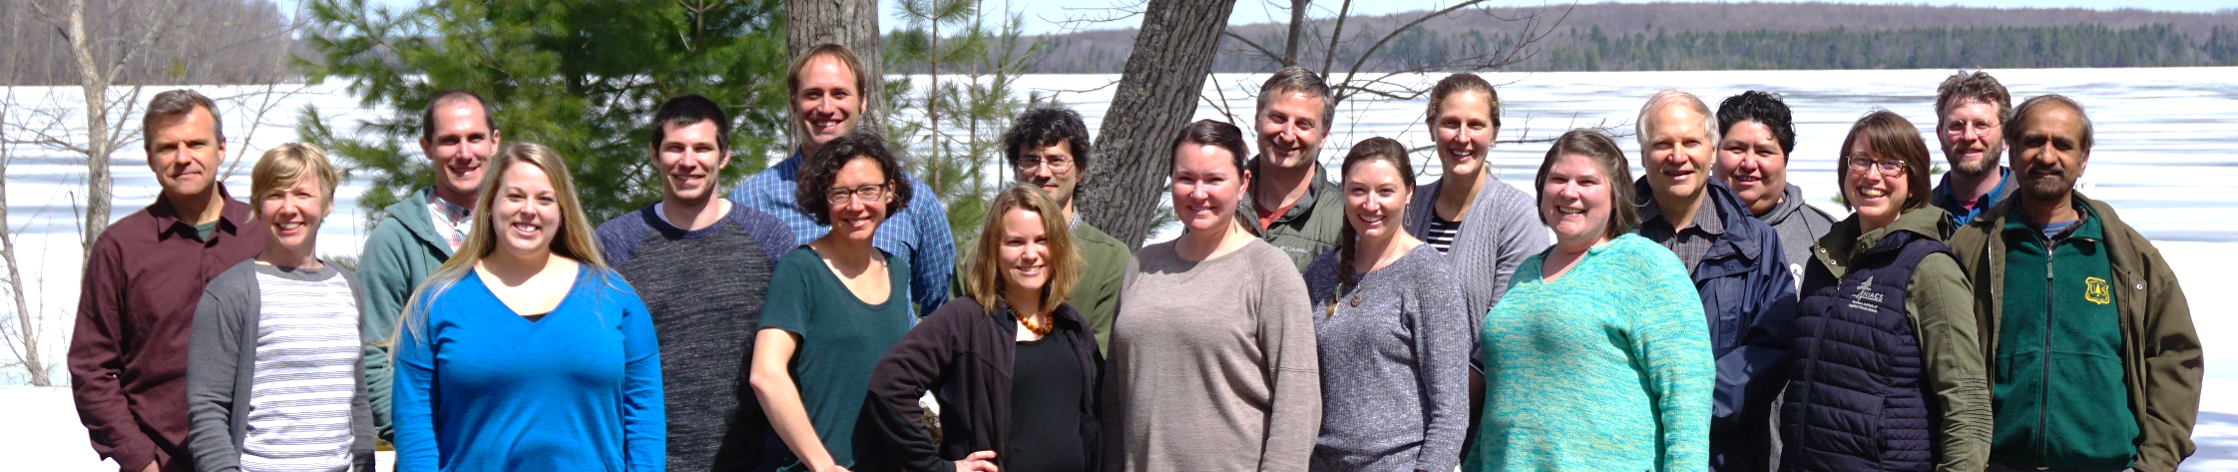








Northern Institute of Applied Climate Science
Climate
Chartered by USDA Forest Service, universities, non-profit and tribal conservation organizations
Carbon
Notes:
KMs:
We span the boundary between academic research and the practical information and support that land managers need to make decisions
The FS provides primary support, but all these orgs provide partnership, support, and perspective
They have different values and views on land management, but agree that a boundary spanning org like ours is needed
Unusually large group we are one of the biggest adaptation-focused groups in the country with 20 people, half of whom engage in direct technical assistance to stakeholders. We also have an in-house vegetation impacts modeling team and a growing staff emphasizing carbon management

Slide 5

Northern Institute of Applied Climate Science
Provide science translation, professional training, and technical assistance to help natural resource professionals in address climate and carbon issues in their work
Pursue new scientific research and science synthesis related to carbon biogeochemistry, climate impacts, and tree species responses
Lead climate change communication and outreach for land managers via several regional and national outlets
CORE PROJECTS:
Carbon Trends and Management
Radiocarbon Collaborative
Landscape Change Research Group
Adaptive Silviculture for Climate Change
Climate Change Response Framework
USDA Climate Hubs
Climate Change Resource Center
www.niacs.org
Notes:
Our work at NIACS is continually expanding and changing, but we can summarize our work along three main ideas, all focused on making scientific information more accessible and actionable. We…
We have a number of core projects and efforts underway. For the purposes of today’s presentation and the focus on collaboration, I want to talk about how our work at NIACS is designed to bring together forest managers and scientists to address new issues and challenges.
Key messages:
We are one of the biggest adaptation-focused groups in the country with 20 people, half of whom engage in direct technical assistance to stakeholders.
We also have an in-house vegetation impacts modeling team and a growing staff emphasizing carbon management

Slide 6
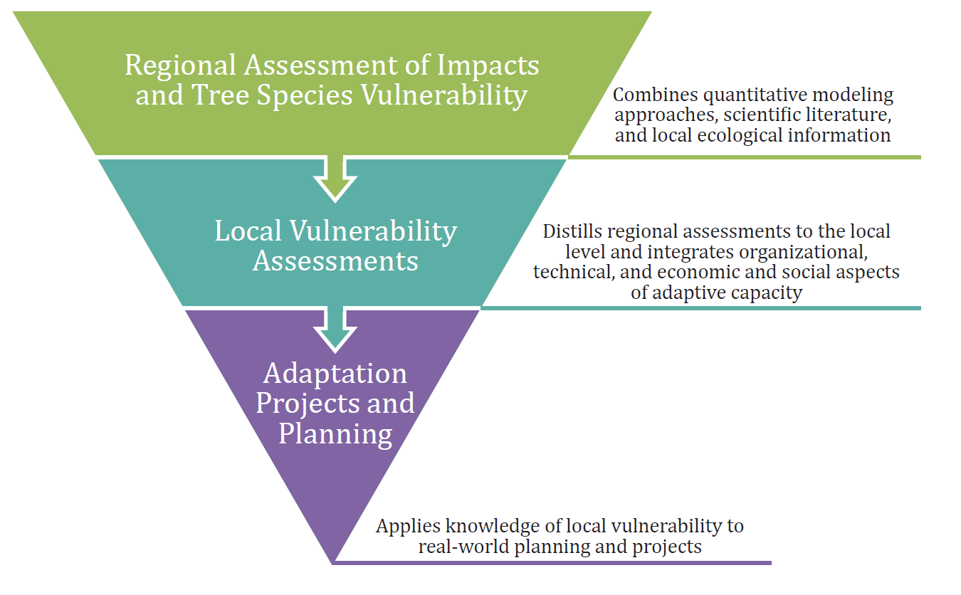
Urban Forestry
Climate Change Response Framework
Brandt et al. 2017. Environmental Science and Policy
Notes:
Recently, we developed the Urban Forestry Climate Change Response Framework. This three-tiered approach begins with a regional assessment of vulnerability, then steps it down to the municipal or park district, and finally the project level to develop adaptation strategies at a local scale.
The framework, which builds on our previous work on adaptation, has three main components:
Assess vulnerability of climate change impacts and tree species vulnerability for a metropolitan region
Work with individual communities to assess the vulnerability of their urban forests to climate change
Work with these communities to incorporate their information into real-world projects.

Slide 7
Today’s Objectives
Understand the impacts of climate change on the Detroit region
Gain knowledge about the vulnerability of Detroit’s trees to current and projected climate changes
Develop a sense of how climate change can interact with other factors such as land use change to impact the area’s urban forest

Slide 8

Poll!

Slide 9
Today’s Agenda
10:15 Changing Climate in the Detroit Region-Matt Peters
10:45 Vulnerability and Adaptive Capacity of Trees and Urban Forests in the Detroit Region-Leslie Brandt and Annamarie Rutledge
11:30 The Impact of Urban Sprawl on Forest Landscapes in Southeast Michigan-Robert Goodspeed and Dimitrios Gounaridis U. of Michigan
12:00 Adjourn

Slide 10
Vulnerability and Adaptive Capacity of Trees in the Detroit Region
Leslie Brandt and Annamarie Rutledge
Northern Institute of Applied Climate Science
Climate Change Adaptation in the Detroit Region’s Urban Forest
January 26, 2021

Slide 11
Vulnerability
The degree to which a system is susceptible to, and unable to cope with, adverse effects of climate change, including climate variability and extremes (IPCC 2007)
Adaptive Capacity
Potential Impact
Vulnerability
Figure: Glick et al. 2011
Notes:
Today we are going to talk about “vulnerability.” So, let’s start with a definition. In the context of climate change, we mean….

Slide 12
Vulnerability
The degree to which a system is susceptible to, and unable to cope with, adverse effects of climate change, including climate variability and extremes (IPCC 2007)
Adaptive Capacity
Potential Impact
Vulnerability
Figure: Glick et al. 2011
Notes:
So what are the impacts to trees?

Slide 13
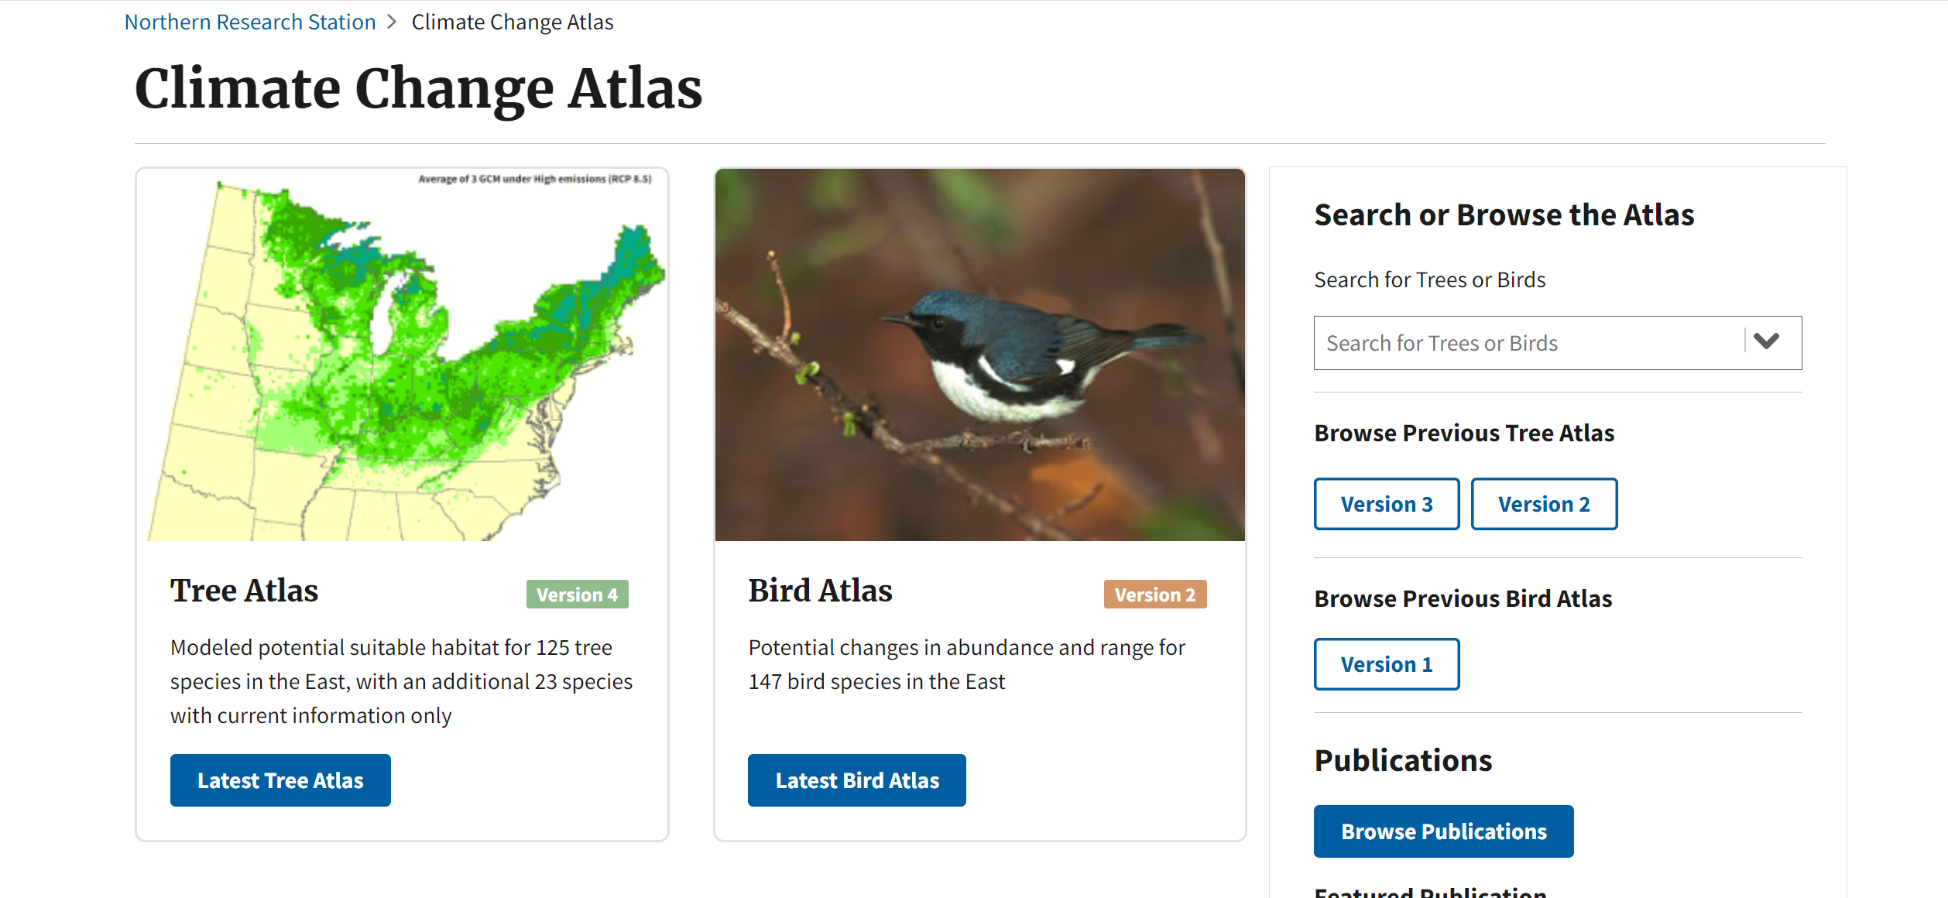
Native Trees: Climate Change Tree Atlas
https://www.fs.fed.us/nrs/atlas/
Notes:
For native trees we have a great resource called the climate change atlas. The atlas uses measured tree inventory data to develop a statistical model that projects where suitable habitat may be in the future.

Slide 14
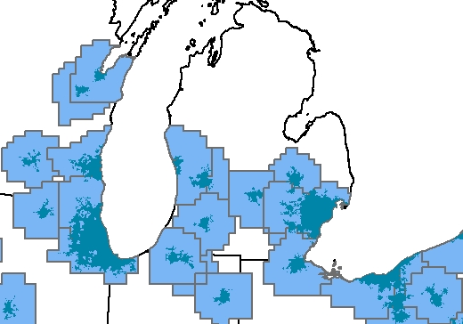
Tree Atlas
Summary Area
Notes:
Recently, the tree atlas has provided summaries for large metropolitan areas. These have been summarized in the draft assessment for the area shown here.

Slide 15
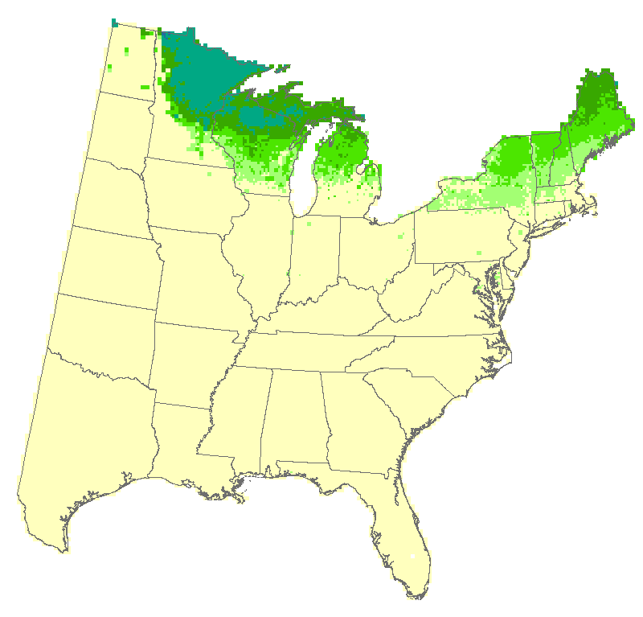
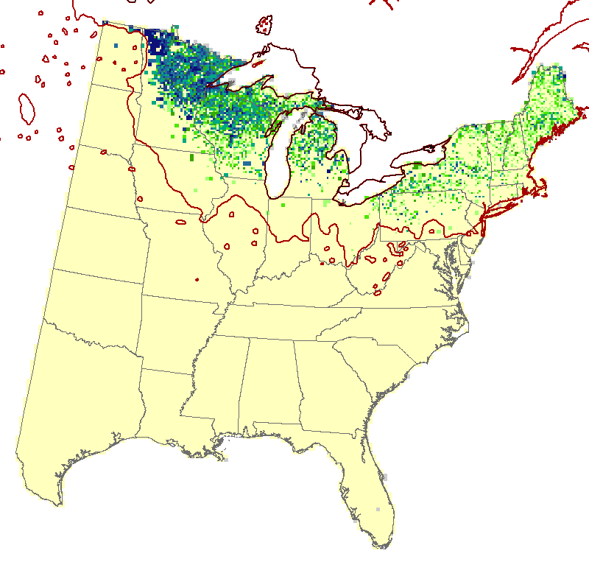

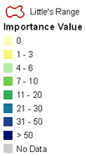
Decreasing: Quaking Aspen
End of Century
High emissions
Current
Low emissions
Notes:
Species that are adapted to more northern climates are expected to lose habitat, such as quaking aspen.

Slide 16
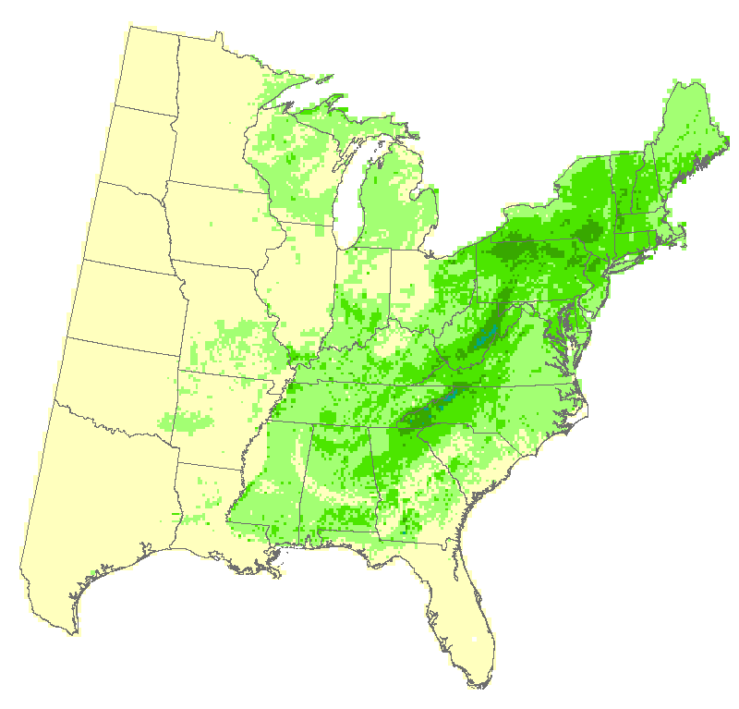
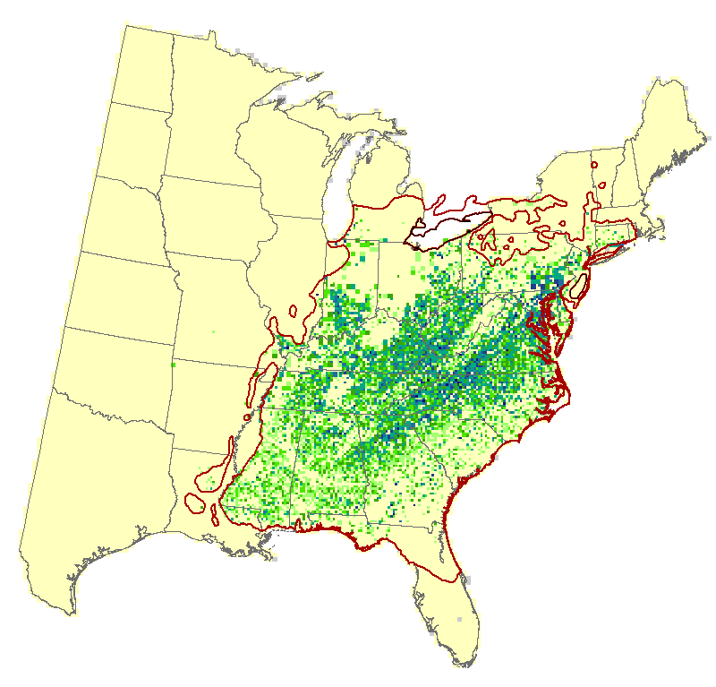
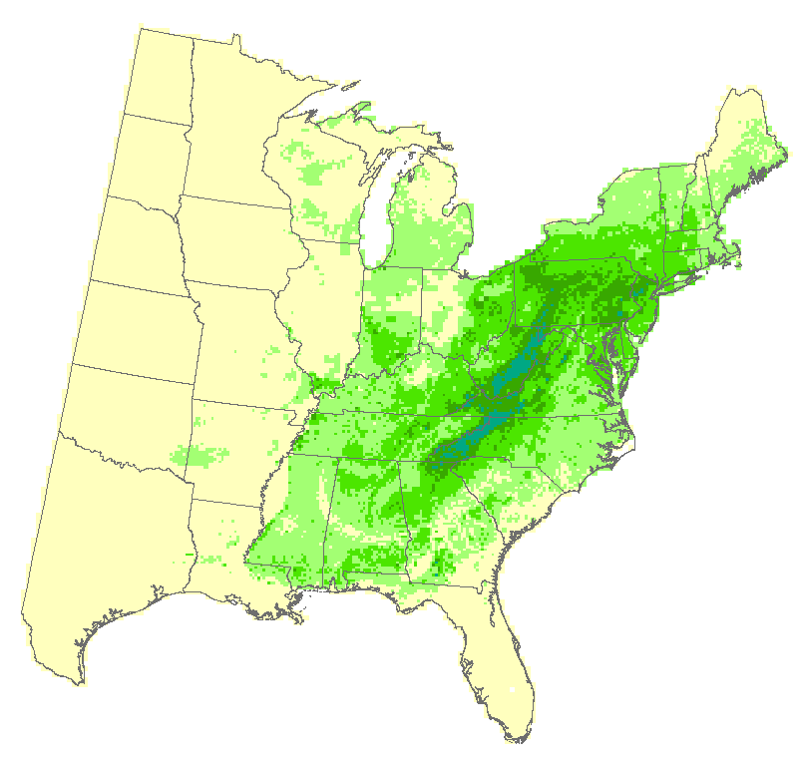
Increasing: Tulip Tree/
Yellow Poplar
End of Century
High emissions
Low emissions
Notes:
Tulip tree or yellow poplar is a species that is currently at its northern extent in the Detroit region and expected to expand its habitat suitability into most of Michigan.

Slide 17
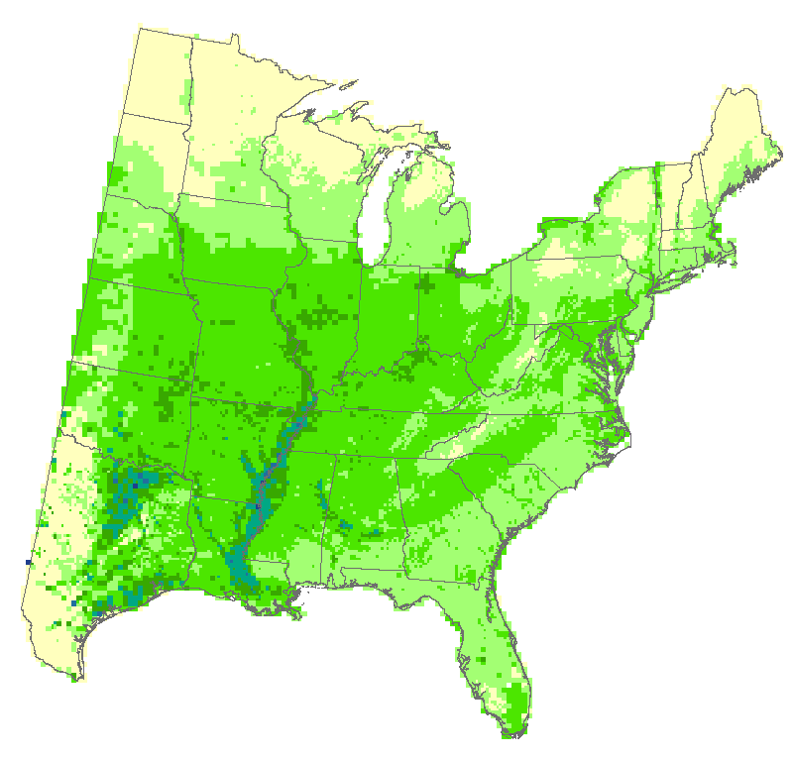
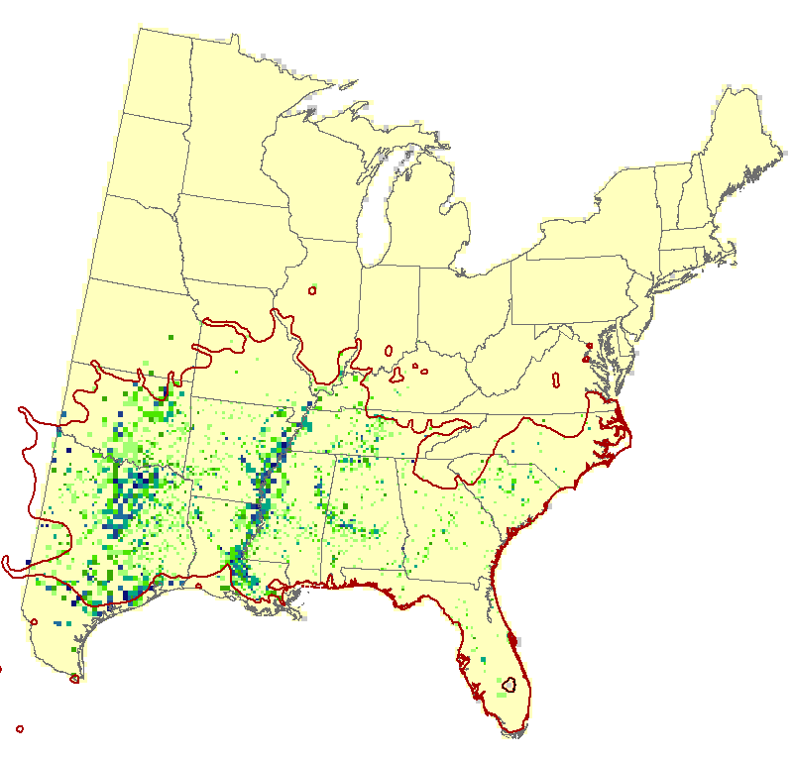
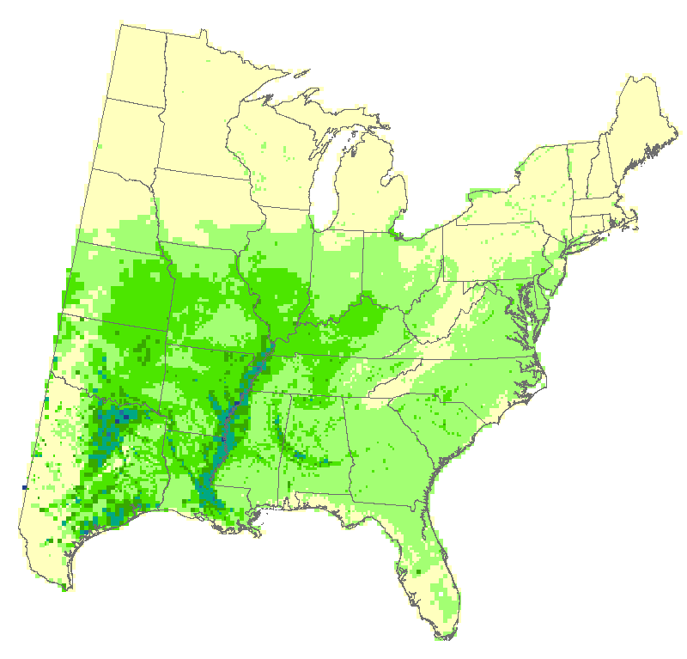
New Habitat: Sugarberry
End of Century
High emissions
Low emissions
Notes:
Some species not currently present here could also gain suitable habitat, such as sugarberry, a close relative of our northern/common hackberry.

Slide 18
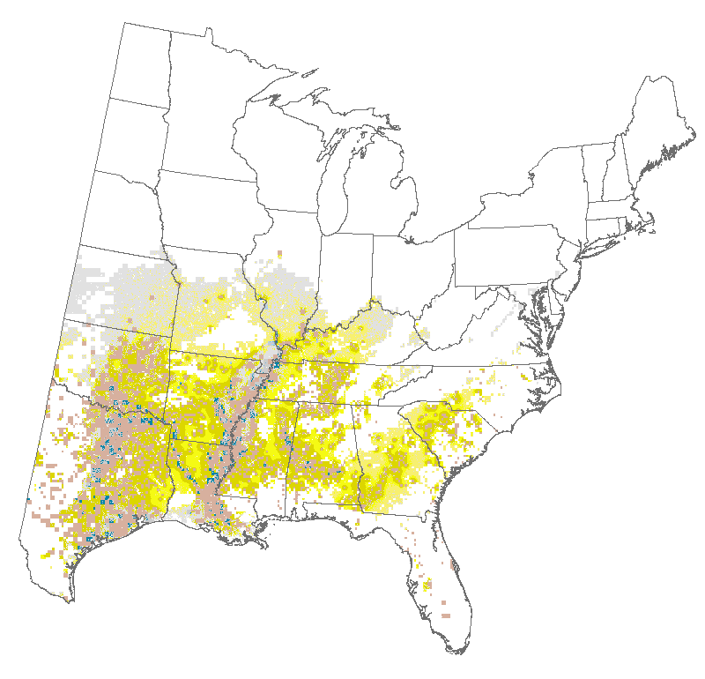
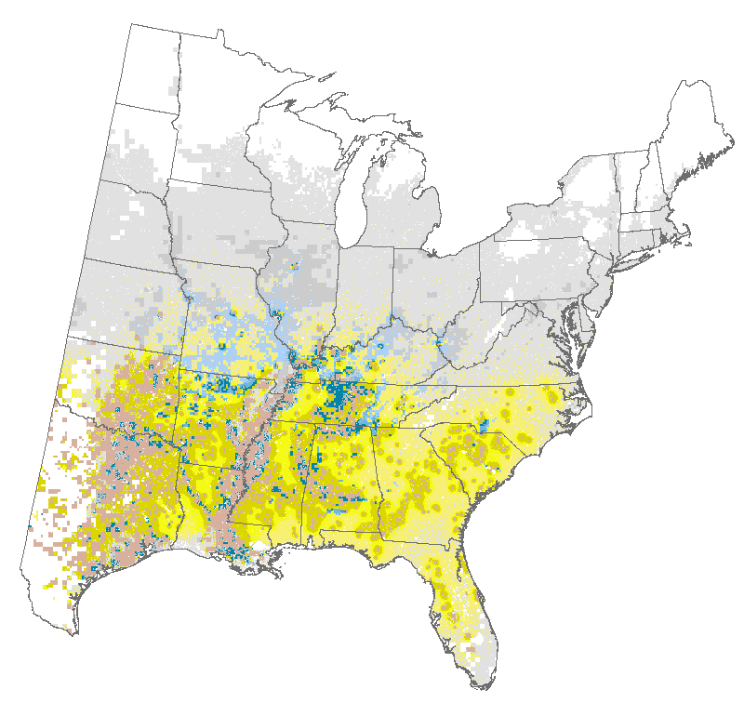
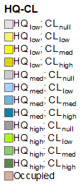
Migration Potential: Sugarberry
Notes:
However, sugarberry is unlikely to migrate here on its own. The dark colored areas represent where colonization is likely, ang grey areas are where it is unlikely to migrate. Thus, sugarberry is something that will only become part of the landscape if we choose to plant it here.

Slide 19
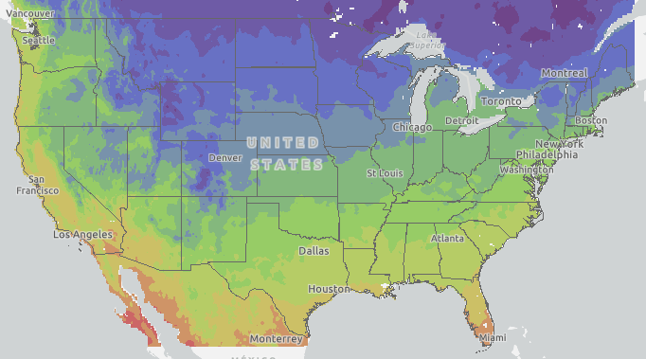
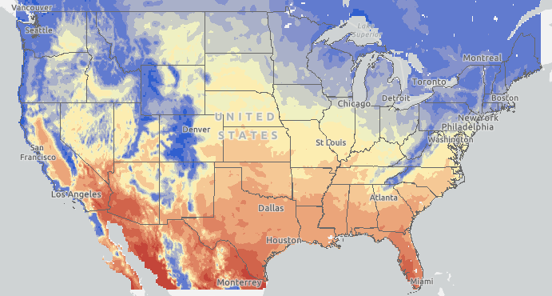
Impacts:
Non-native, less common species, shrubs, and cultivars
Hardiness Zones
  Based on the coldest average temperature over a 30 year period
  Species tolerance compared to current and projected zones in the Detroit region
Heat Zones
  Based on the number of days over 86 degrees F
  Species tolerance compared to current and projected zones in the Detroit region
Historical Hardiness & Heat Zones, 1980-2009
Notes:
We unfortunately do not have models like this for all species, including non-native species, uncommon speciesk, shrubs, and cultivars. For these species, we can determine future habitat suitability by examining future hardiness and heat zones.

Slide 20
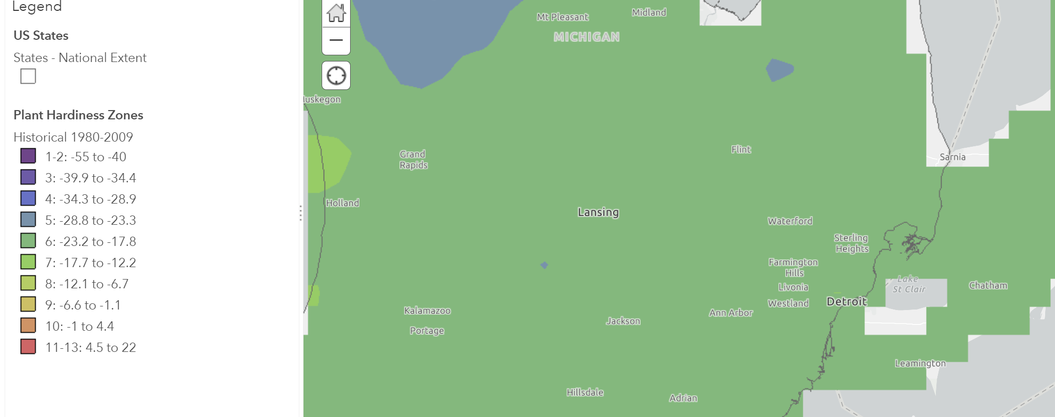
“Current” Hardiness Zone
Source: https://usfs.maps.arcgis.com/home/webmap/viewer.html?webmap=611d3e5ac1774a21a6ff55aceb8f588c
Notes:
Detroit is currently a zone 6 for hardiness, meaning any species with a zone tolerance of 6 or lower can be planted here.

Slide 21
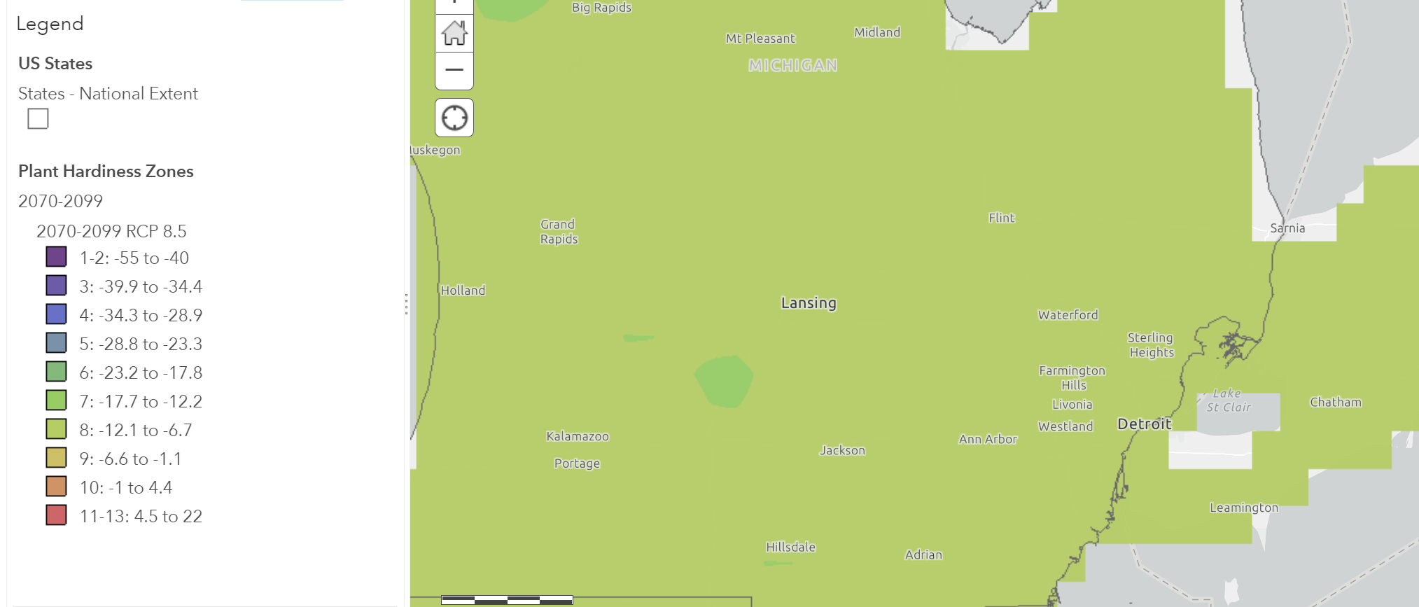
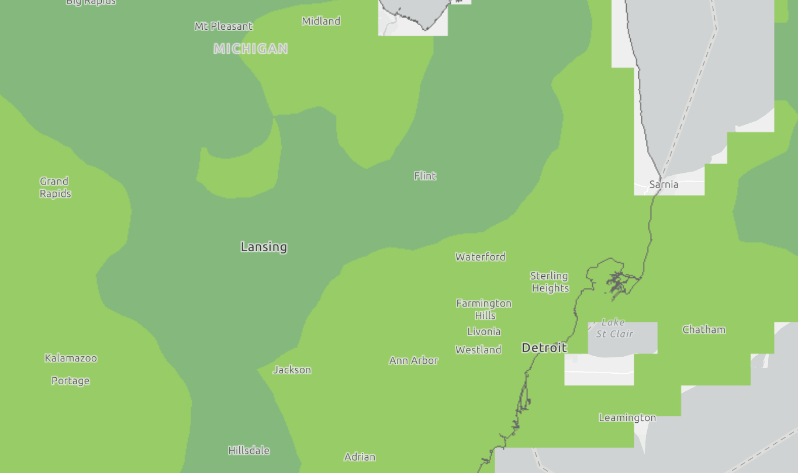
Future Hardiness Zone: End of Century
High Emissions
Low Emissions
Source: https://usfs.maps.arcgis.com/home/webmap/viewer.html?webmap=611d3e5ac1774a21a6ff55aceb8f588c
Notes:
By the end of the century, we could reach a zone 8 under a high emissions scenario, or a zone 7 under a low emissions scenario. So some species that couldn’t be planted before may be able to be planted .

Slide 22
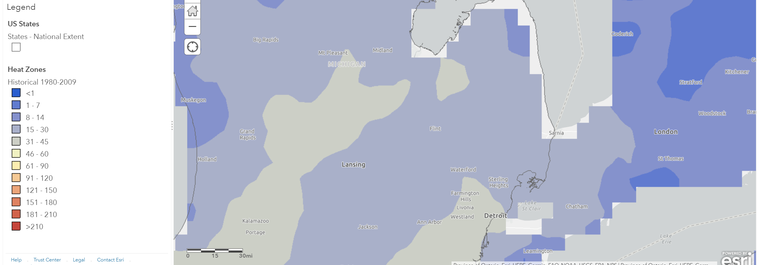
“Current” Heat Zones
https://usfs.maps.arcgis.com/home/webmap/viewer.html?webmap=2a224eac04924285a094190c8e08a459
Notes:
For heat zones, we are a zone 4-5 in the Detroit region, meaning there are typically 15-45 days above 86 degrees F

Slide 23
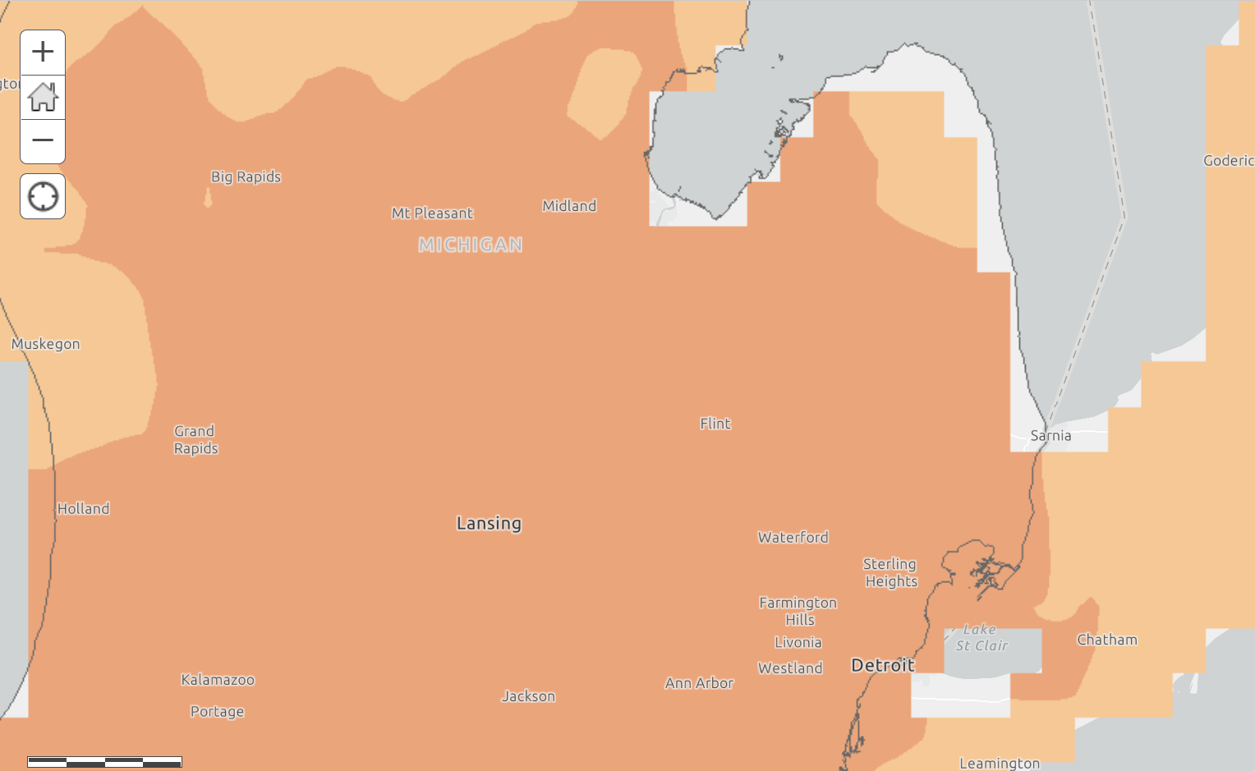
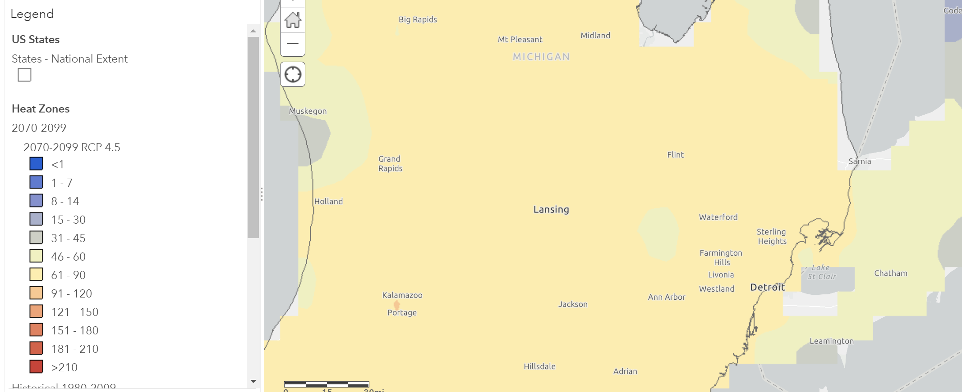
Future Heat Zone: End of Century
High Emissions
Low Emissions
https://usfs.maps.arcgis.com/home/webmap/viewer.html?webmap=2a224eac04924285a094190c8e08a459
Notes:
By the endod the century, we expect to be between a zone 7 and 9, meaning we could have 61-150 days above 86 degrees. A lot of the species we currently plant are only tolerant up to a zone 7 or 8, which means summers could be too hot for some species.

Slide 24
Vulnerability
The degree to which a system is susceptible to, and unable to cope with, adverse effects of climate change, including climate variability and extremes (IPCC 2007)
Adaptive Capacity
Potential Impact
Vulnerability
Figure: Glick et al. 2011
Notes:
Recall vulnerability also depends on adaptive capacity. So how do we measure the adaptive capacity of trees?

Slide 25
Adaptive Capacity Factors
Based on Matthews et al. 2011
Disturbance Factors
Pest, disease, fire, drought, flood, pollution, heat,
herbivory, invasive species, salt resistance
Biological Factors
Shade tolerance, edaphic specificity, propagation, pruning
needed, establishment, rooting conditions
-3
0
3
Notes:
To assess adaptive capacity, we rated species for their tolerance of different disturbance factors such as pests, drought, and flooding.
We also rated them based on their ability to thrive in a variety of environments, such as soils, shade, and restricted rooting conditions.
This information was gathered from existing literature and reviewed by experts in urban forestry and horticulture.

Slide 26
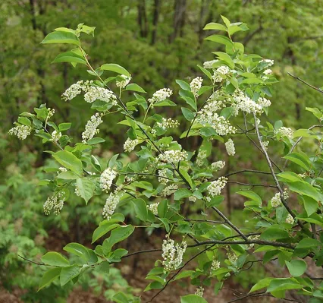
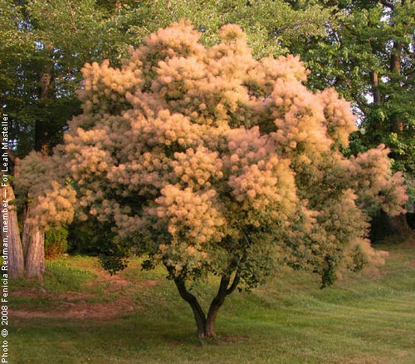
Adaptive Capacity
Low Adaptive Capacity:
Black cherry (Prunus serotina)
High Adaptive Capacity:
Smoketree (Cotinus coggygria)
Can neither tolerate drought nor extensive flooding; limited planting sites for urban areas
Drought and urban tolerant

Slide 27
Vulnerability
The degree to which a system is susceptible to, and unable to cope with, adverse effects of climate change, including climate variability and extremes (IPCC 2007)
Adaptive Capacity
Potential Impact
Vulnerability
Figure: Glick et al. 2011
Notes:
Once we had both the potential impacts on a species and their vulnerability, we were able to assess their vulnerability

Slide 28
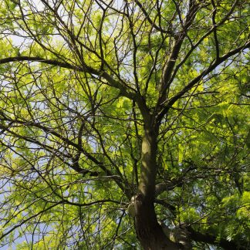
Tree Species Assessed
187 Species
  148 present in Detroit based on TreeKeeper data
  40 additional species of interest
Canopy, common sub-canopy trees native to the Detroit region
Non-native species and many cultivars of trees that are currently present
Invasive tree species
Notes:
In the Detroit region, we assessed 187 species, including…

Slide 29
Vulnerability Matrix
Zone
Suitability
Adaptive Capacity
Low
Medium
High
High Vulnerability | Moderate-high Vulnerability | Moderate Vulnerability
Moderate Vulnerability | Low-moderate Vulnerability | Low Vulnerability
Not suitable
Suitable
Zone suitability: Trees are considered suitable if:
1. Species hardiness zone tolerance ≤ current hardiness zone AND
2. Species heat zone tolerance ≥ projected heat zone
Notes:
Species were categorized into one of 5 vulnerability categories based on their zone suitability in the current and future and their adaptive capacity score.

Slide 30
Number of Species in Each Vulnerability Category-based on adaptive capacity in planted sites
Notes:
The number of vulnerable species varied between the low and high emissions scenario. Under a low emissions scenario, very few species fell under the moderate-high or high vulnerability category. But under the high emissions scenario, the most common vulnerability category was moderate-high.

Slide 31
Number of Trees in Each Vulnerability Category-based on adaptive capacity in planted sites
Notes:
If we instead look at the number of street trees planted, many more trees are in the low-moderate range. This means either managers are selecting for more adaptable trees already, or they are experiencing a much lower mortality, as you’d expect.
There are still a lot of trees in the moderate-high vulnerability category under a high emissions scenario, so those trees may some we may want to keep an eye on in the near future.

Slide 32
Vulnerability of Detroit’s top 20 most common trees
Common Name | # of Trees (TreeKeeper) | Vulnerability - Low Emissions | Vulnerability - High Emissions
Norway maple*** | 30,157 | moderate | moderate
honeylocust (thornless) | 22,971 | low-moderate | low-moderate
silver maple* | 20,476 | low-moderate | moderate-high
red maple* | 7,287 | low | low
London planetree | 6,971 | low-moderate | low-moderate
American sycamore* | 5,771 | low-moderate | low-moderate
green ash* | 5,705 | low-moderate | low-moderate
littleleaf linden | 5,396 | low | moderate
sugar maple | 5,240 | low-moderate | moderate-high
Siberian elm** | 4,897 | low-moderate | low-moderate
callery pear | 2,936 | low-moderate | moderate-high
American elm | 2,509 | low-moderate | low-moderate
American linden or basswood* | 2,482 | low-moderate | moderate-high
white mulberry | 2,308 | low-moderate | moderate-high
common hackberry** | 2,270 | low | low
northern red oak | 2,234 | low-moderate | low-moderate
pin oak* | 2,033 | low-moderate | moderate-high
northern catalpa | 1,238 | low-moderate | moderate-high
ginkgo | 1,220 | low | low
common horse chestnut | 1,180 | low-moderate | moderate-high
*Flood-tolerant, **Drought-tolerant, ***Flood- and Drought-tolerant
Notes:
What’s driving this is a lot of the most commonly planted species have low vulnerability. Under a low emissions scenario, most of the species have low-moderate vulnerability.
Many more species have moderate-high vulnerability under the high emissions scenario.

Slide 33
Key Points
Species at southern extent of their ranges are expected to lose habitat
Species that are heat, drought, and flood-adapted and pest/disease resistant have high adaptive capacity
Most common species in Detroit are not vulnerable under a low emissions scenario, but more are vulnerable under a high emissions scenario

Slide 34
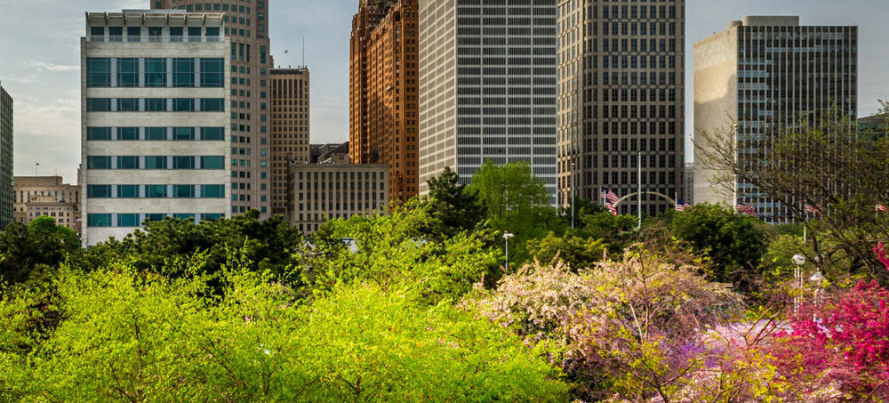
Vulnerability of the Urban Forest
Notes:
This section will provide an overview of vulnerability in Detroit’s urban forest, including impacts and adaptive capacity.
It will focus on the vulnerability at a more local level, examining impacts in each of Detroit’s seven districts to determine which will be more vulnerable to climate change and thus, point to where resources can be strategically implemented to build climate resilience.

Slide 35
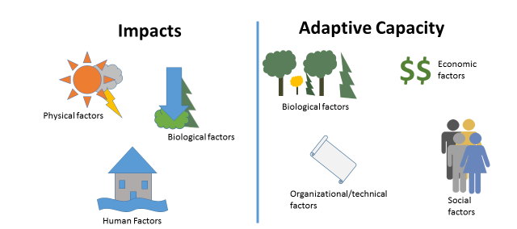
Community Vulnerability
Notes:
When assessing the vulnerability of an entire urban forest or ecosystem, it’s important to keep other factors in mind.
When assessing impacts:
- You’ll want to consider how physical factors like elevation or soil type may affect your susceptibility to drought or flooding.
- You’ll also want to consider how biological factors like a high proportion of vulnerable trees or the presence of particular pests or diseases may make your impacts more pronounced.
- You’ll want to also consider human-influences factors such as the amount of impervious surface, the influence of the urban heat island, or past management in your particular site.
When considering adaptive capacity of your urban forest, you’ll want to consider:
- Biological factors such as the amount of biological or genetic diversity of urban forest
- The amount of funding available to support urban forestry efforts
- Organizational and technical factors such as the number of trained staff to do the work, or how flexible policies are.
- Finally, you’ll want to consider social factors such as support from the community to assist with tree care and planting.

Slide 36
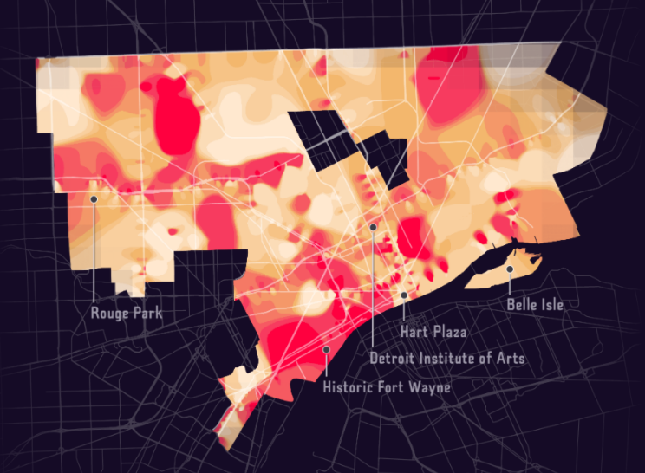
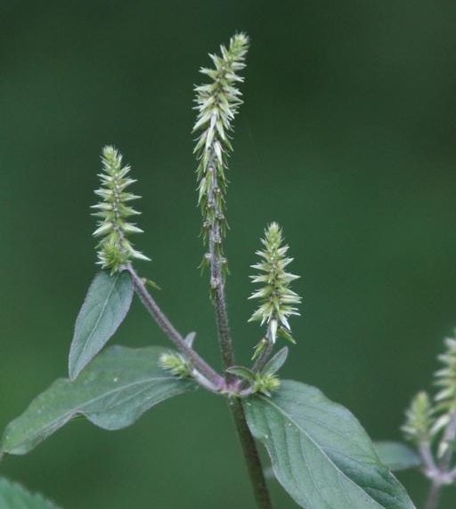
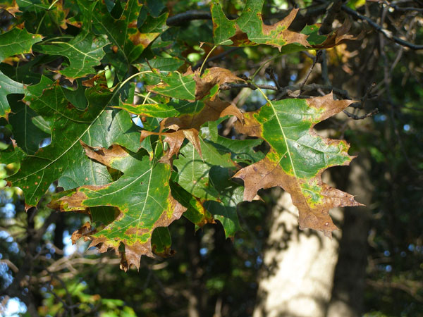
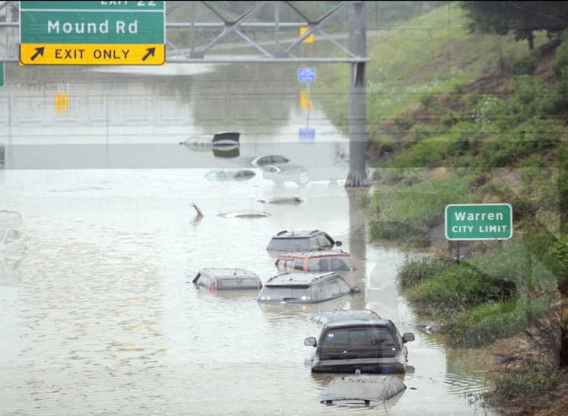
Region-wide Impacts
Invasive plant species
Pests and pathogens
Urban Heat Islands (UHI)
Flooding and runoff
Notes:
- A changing climate has the potential to affect physical and biological stressors to Detroit’s urban forest.
- Four significant impacts for the SEMCOG region include invasive plant species, pests and pathogens, urban heat islands, and flooding and runoff.

Slide 37
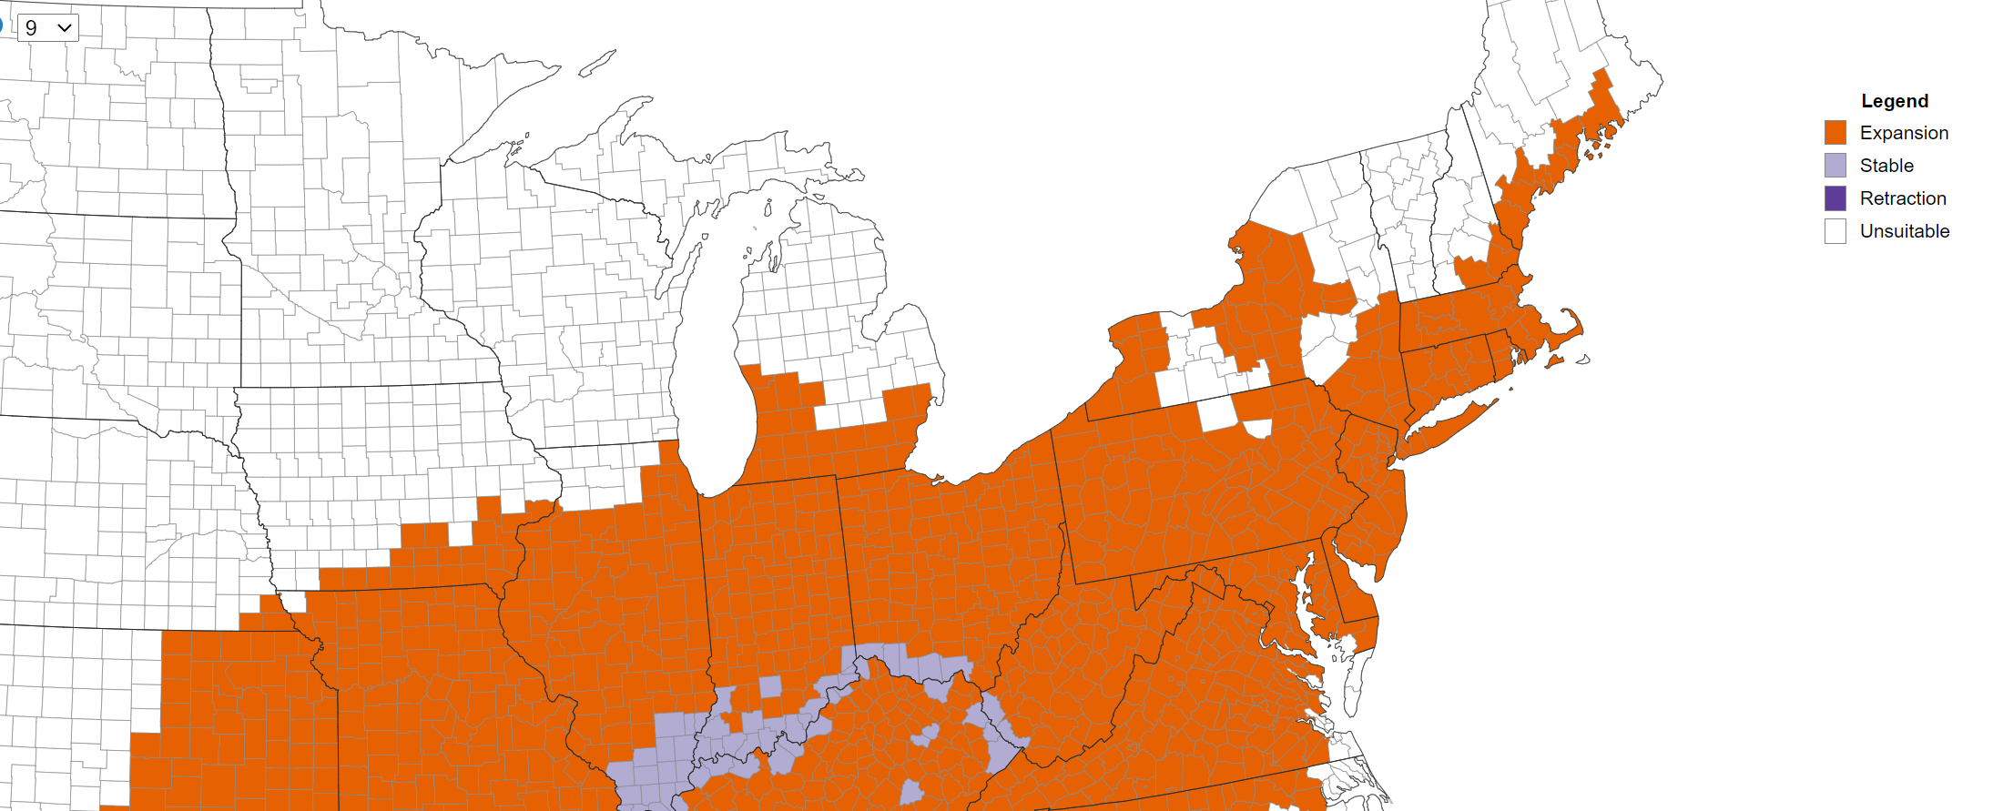
Japanese Chaff Flower Habitat Suitability
End of Century
https://www.eddmaps.org/distribution/
Notes:
- Invasive plant species can out-compete native trees in urban natural areas.
- As non-native, invasive plants shift their range in the face of a changing climate, hotspots are projected to develop, allowing for species to establish and spread.
- Researchers have mapped the future distribution of invasive plants in the Early Detection and Distribution Mapping System (website listed).
- As an example, this map here shows the distribution of Japanese Chaff Flower and its habitat suitability by the end of the century.
- This species is one that is projected to expand across the SEMCOG region.

Slide 38
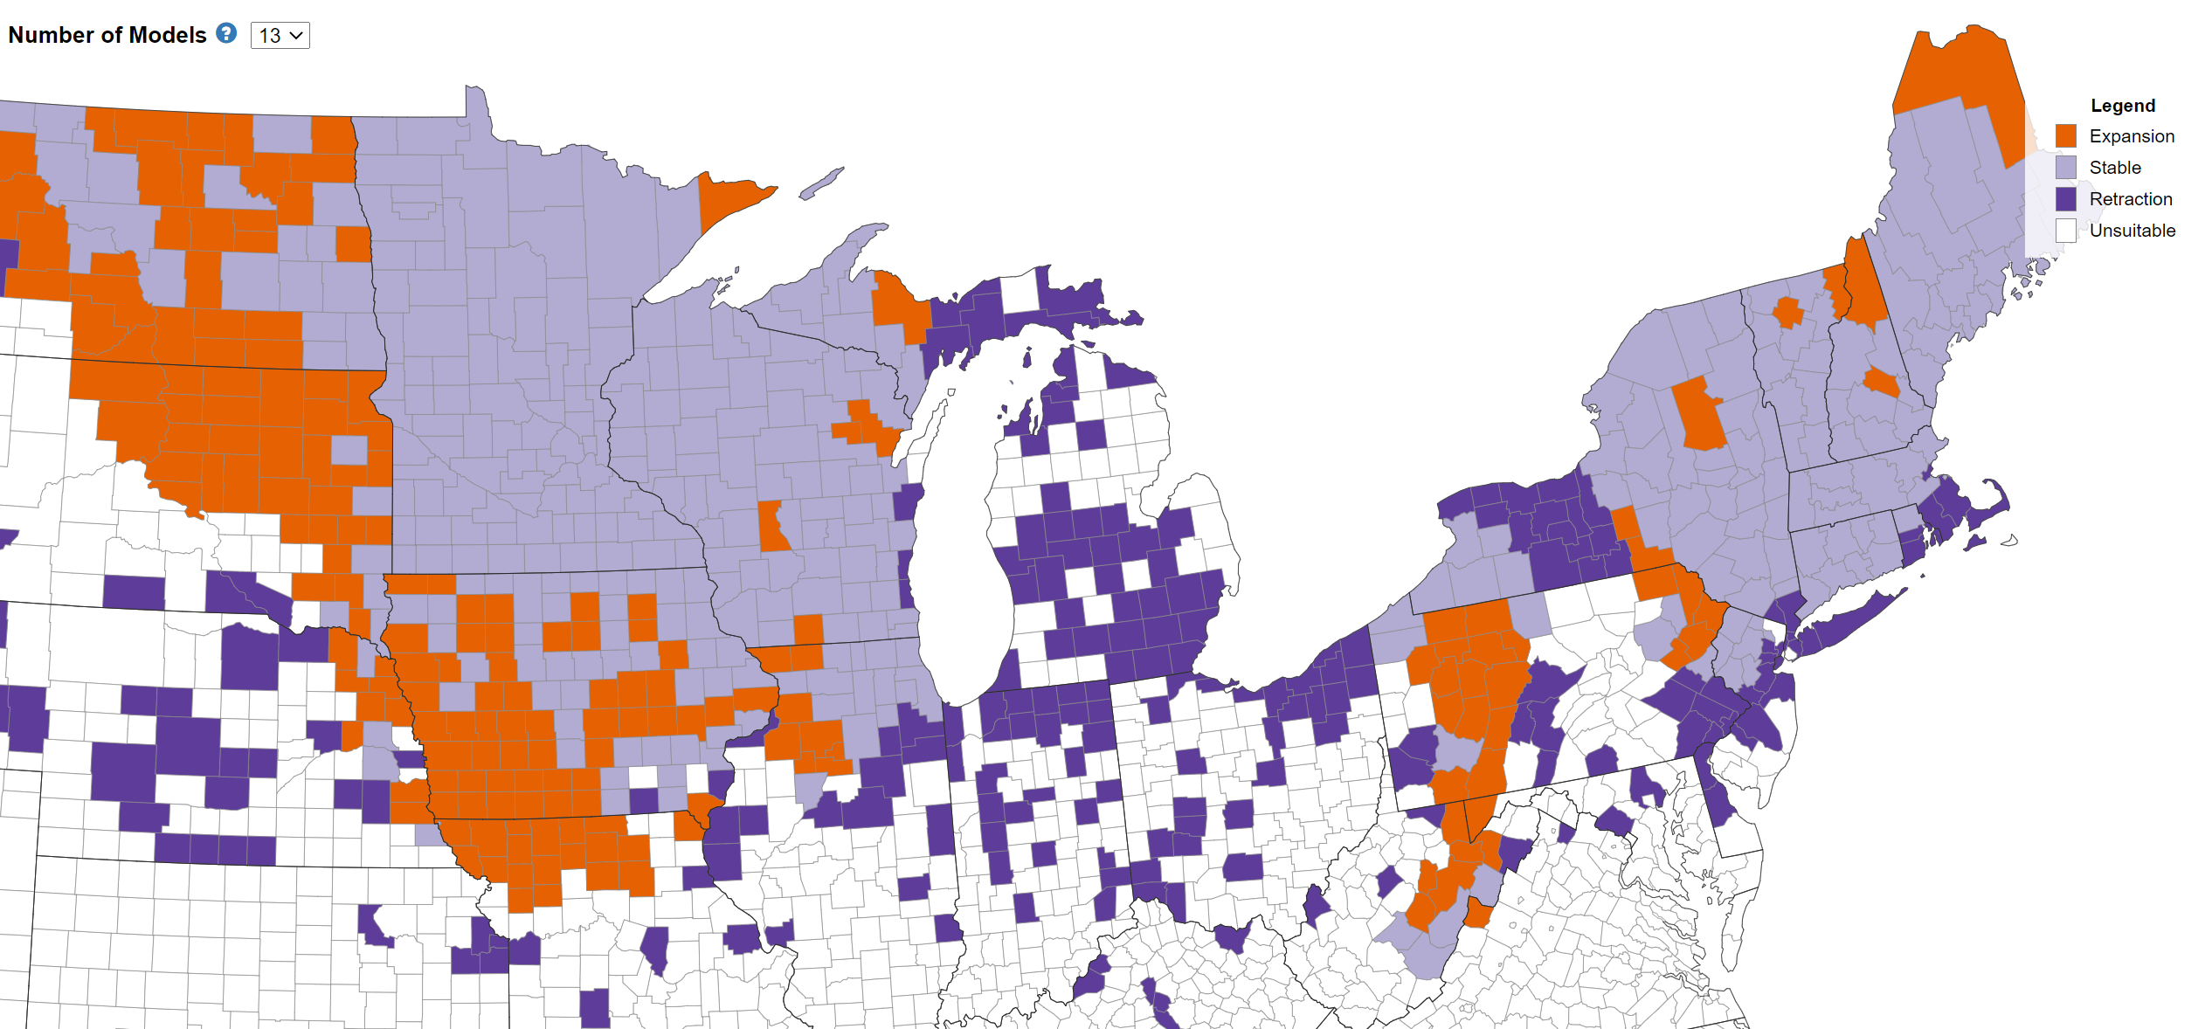
European Buckthorn Habitat Suitability
End of Century
https://www.eddmaps.org/distribution/
Notes:
Here is another example, this time with European Buckthorn.
By the end of the century, this species is projected to retract in all counties with the exception of St. Clair County where it is projected to be unsuitable.
Many common invasives in the Midwest such as garlic mustard, multiflora rose, common burdock, tree-of-heaven, Japanese knotweed, purple loosestrife, spotted knapweed, and wild parsnip are projected to remain stable across the region by the end of the century.

Slide 39
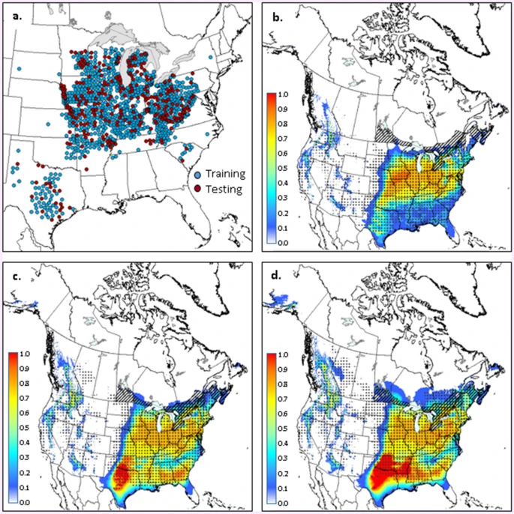
Oak Wilt (B. fagacearum) Habitat Suitability
1981-2010
Training data
2011-2040
2041–2070
Pedlar et al. 2020. https://www.nature.com/articles/s41598-020-75549-w
Notes:
- Oak wilt, a high-mortality oak disease caused by a fungal pathogen, is a prominent concern to Detroit’s land managers.
- The disease benefits from cool, moist conditions for transmission, and from hot, dry conditions for progression.
- Paired with higher precipitation in the spring and increased temperatures and drought in the summer, oak wilt could thrive in the Detroit region.
- It’s currently found throughout Michigan, including the southwest region.
- Climate suitability for oak wilt remains relatively high for each of the time periods including the historical period as well as projections into 2040 and 2041-2070 under a moderate greenhouse gas emissions scenario seen here.
- Oak wilt suitability is projected to move northward, eventually covering much of the oak range in eastern Canada, but continues to remain a threat to the SEMCOG region.

Slide 40
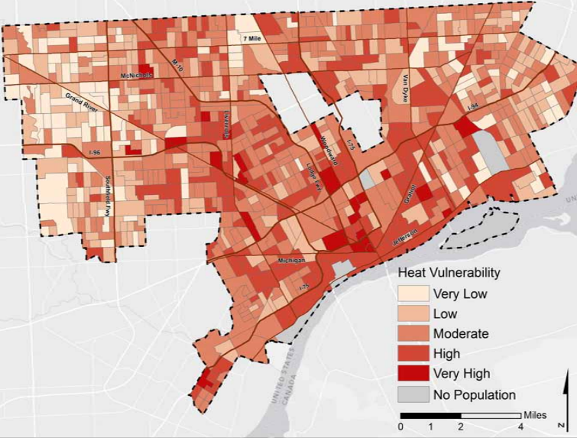
Urban Heat Islands
An urban heat island is an urban area that is significantly warmer than its surrounding rural areas due to human activities.
Notes:
Extreme heat is one of the most prominent climate issues in Detroit.
An urban heat island is an urban area that is significantly warmer than its surrounding rural areas due to human activities.
Impervious surfaces (e.g., concrete and asphalt) absorb heat and radiate it into the air, which increases surface temperatures.
Meanwhile, tree canopy and additional vegetation apply a cooling effect on the surrounding area.
The interaction of these land covers result in areas of the city that are warmer in summer months, and are thus more vulnerable to extreme heat events.
This map shows the greatest areas of vulnerability in dark red.

Slide 41
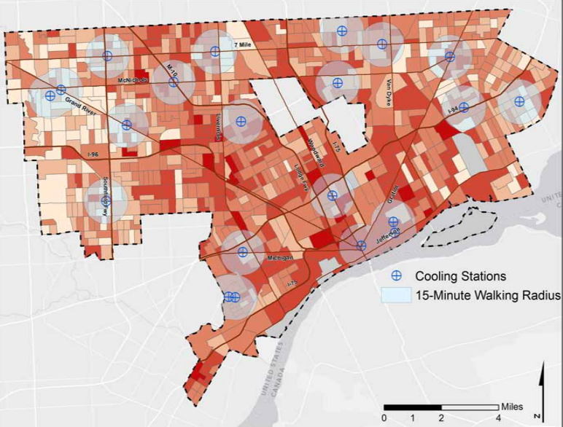
Urban Heat Islands
Notes:
This map shows the heat vulnerability along with the distance to cooling stations and a 15-minute walking radius around them.
29% of Detroit’s population lives within a 15 minute walk of designated cooling centers.
Extreme heat poses a variety of health threats, including heat-related illnesses and mortality as well as worsening air quality due to increased smog, aggravating conditions like asthma.
There are several notable deserts in areas west of downtown (District 7) and on the east side of downtown (District 5) crossing through District 4.
Access is not equal for all, and is a concern especially for areas that have high heat vulnerability and for individuals who are at higher risk from exposure to extreme heat.

Slide 42
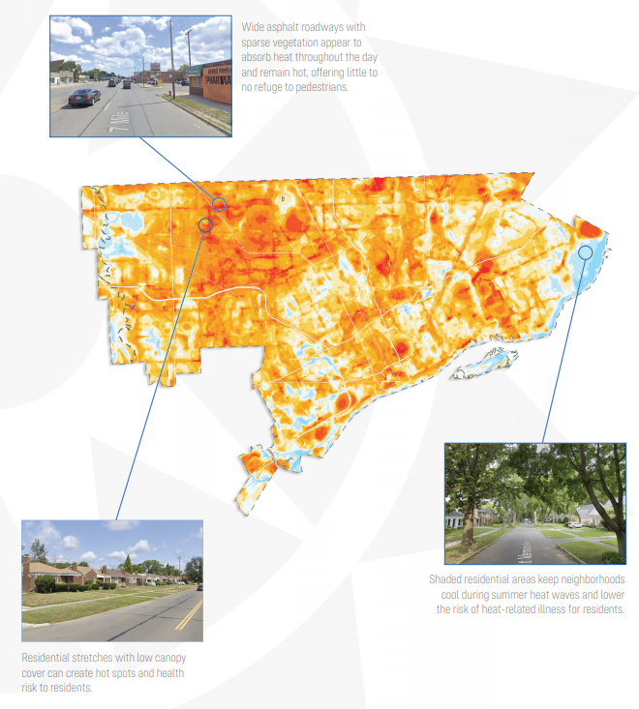
Notes:
- In August, 2020, local organizers and volunteers in Detroit collected over 130,000 temperature and humidity data points in the morning, afternoon, and evening to create a heat watch report for the area (CAPA Strategies).
- This provided images of the distribution of temperature and humidity, describing how heat varies among urban neighborhoods due to local landscape features.
- Notable observations for the Detroit area include the presence of asphalt roadways and canopy cover.
- Wide, asphalt roadways absorb heat and remain hot during the day and hotspots are created by residential stretches of low canopy cover.
- Cooler areas of the city are seen in shaded, residential neighborhoods that are kept cooler during heat waves by the high canopy cover.

Slide 43
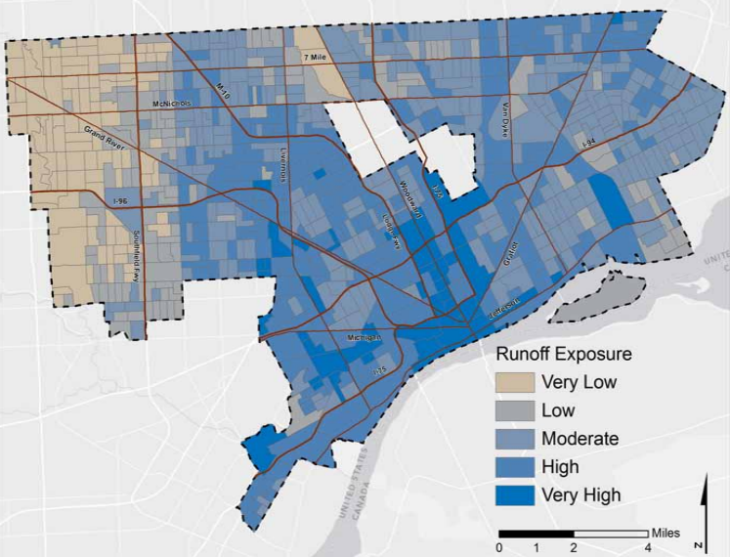
Runoff Exposure
Notes:
- Much of the soil is poorly drained throughout Detroit and in the spring and fall when the ground is already wet and less likely to hold more water, the city is projected to be met with more rainfall - up to 25 percent by the end of the century
- One of the major concerns with additional rainfall is that Detroit’s aging stormwater systems could be overwhelmed by increased precipitation, resulting in flooded streets and basements and lead to sewage overflows in the Detroit River and Lake Erie.
- Detroit’s Climate Change Vulnerability Report from the University of Michigan conducted a flood assessment that examined the vulnerability of infrastructure systems and household-level vulnerability.
- The analysis of infrastructure focused on exposure factors and the primary factor was the runoff burden (determined by land cover, soil type, and slope) that is created during intense storm events.
- The exposure factor at the household-level is determined from floodplain designations (100 and 500 year) and household sensitivity is determined by the age of housing stock as well as the median household income.
- System flood vulnerability, similar to the heat assessment, is concentrated around the downtown core, extending northward.
- Household flood vulnerability is high in southeast Detroit, and along the Rouge River in the northwest.
- Districts 5 and 6 have higher runoff exposure as they are situated along the Detroit River.

Slide 44
Community Vulnerability
Notes:
- We just went through some of the region-wide impacts in Detroit, and now we’ll touch on some of the adaptive capacity factors.

Slide 45

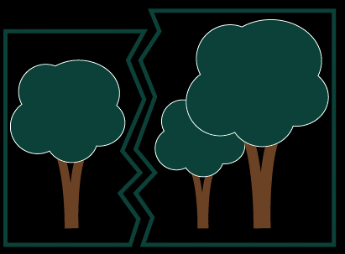
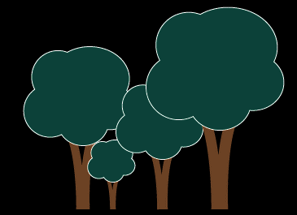
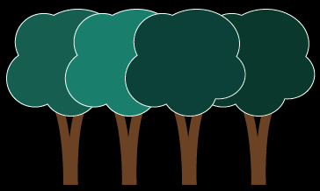
Ecological Adaptive Capacity Factors
Species Diversity
Connectivity
Age Class Diversity
Genetic Diversity
Notes:
Examples of adaptive capacity factors in ecosystems can include things like species diversity, connectivity, age class diversity, and genetic diversity.
These ensure that there are a number of different species at different ages within a given community, that there is variation in the genetic composition, and that there is interconnected land that allows for the movement of energy, matter, and species across the landscape.
Having these different types of adaptive capacity protects the ecosystem and allows the system to be more resilient to change.

Slide 46
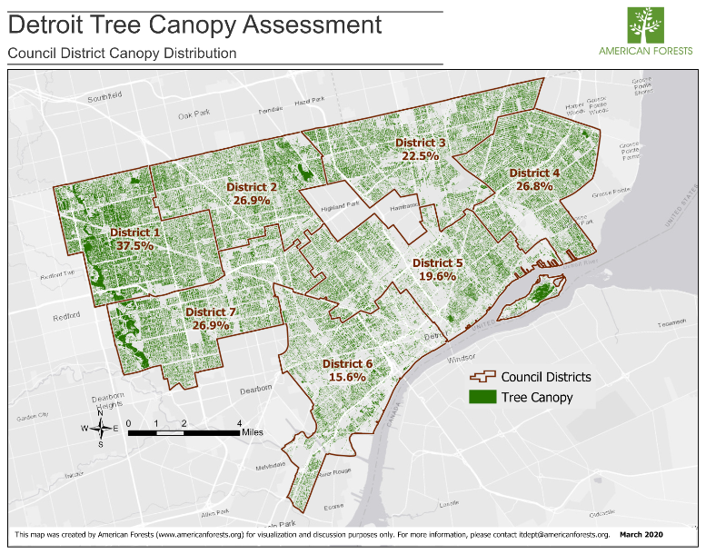
Urban Tree Canopy
Notes:
Here is a Detroit Tree Canopy Assessment by American Forests, demonstrating the amount of tree canopy in each of Detroit’s 7 districts.
Districts with lower canopy cover may experience warmer temperatures and an increase in stormwater runoff as trees play an important role in mitigating the urban heat island effect and also help to intercept rainfall.
Canopy coverage varies by district; the highest canopy cover is found in District 1 (37.5 percent), followed by Districts 2, 4, and 7 at nearly 27 percent, while the lowest coverage is found in District 3 (22.5 percent), District 5 (19.6 percent), and District 6 (15.6 percent).

Slide 47
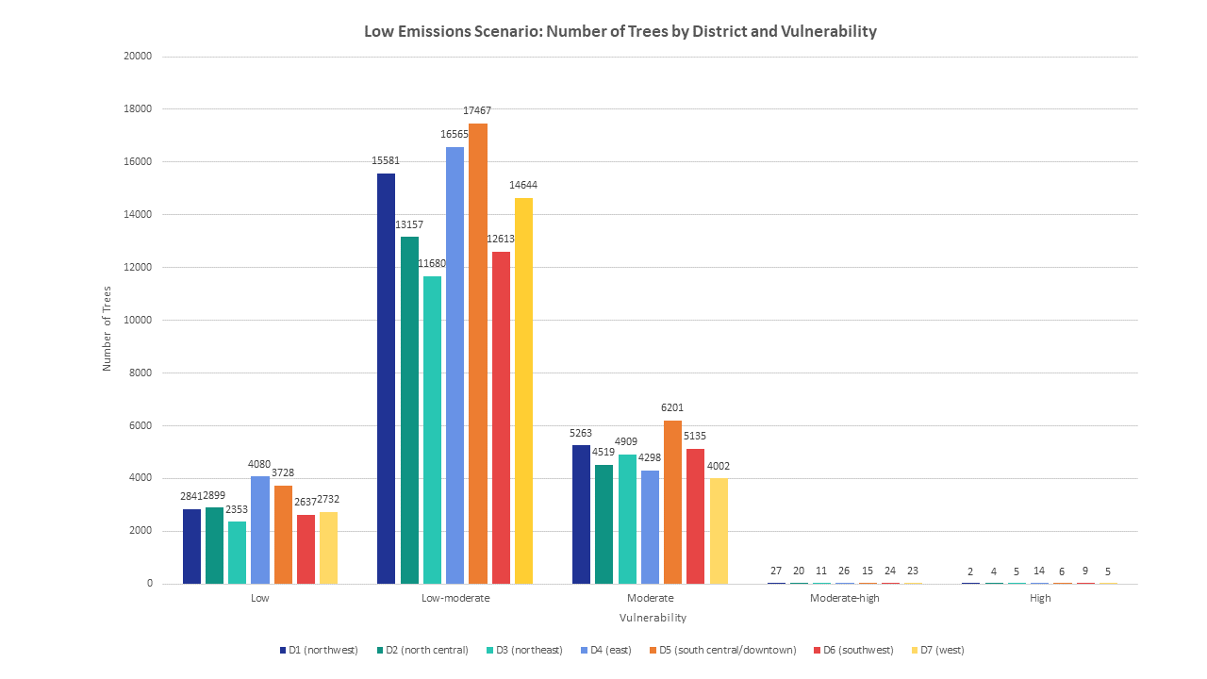
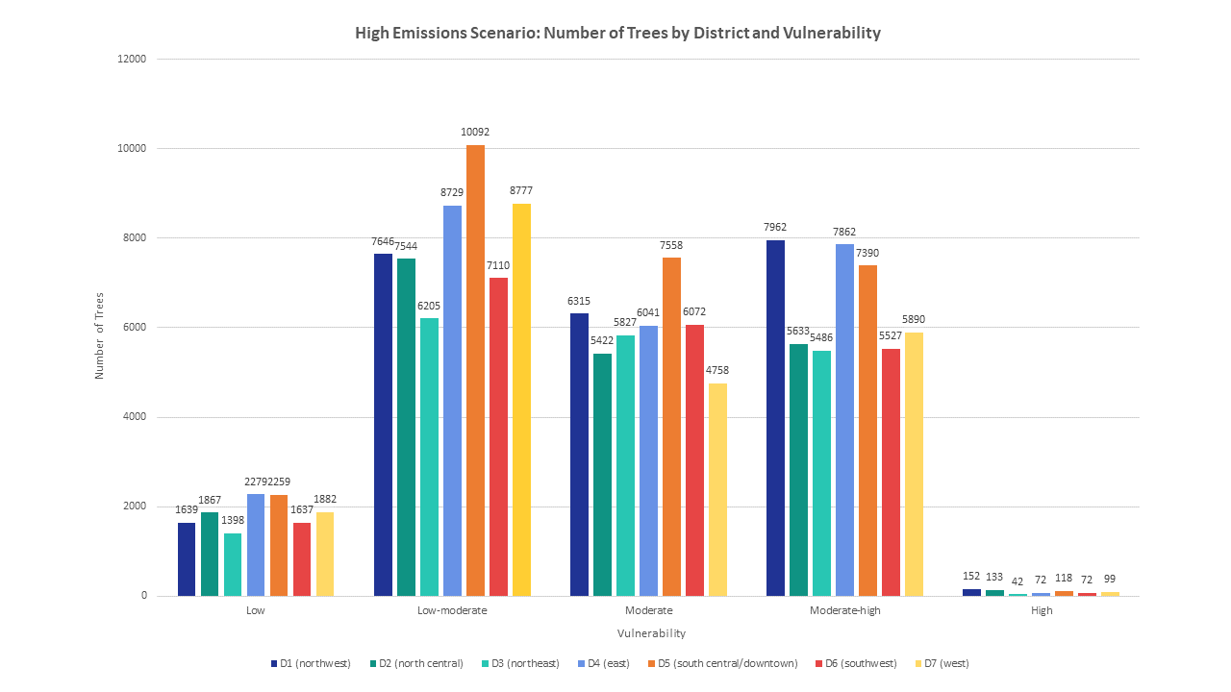
Number of Vulnerable Species
Notes:
This graph shows the number of trees by district and vulnerability level under a low emissions scenario at the top, and high emissions scenario on the bottom.
The vulnerability for each species in Detroit was determined as part of the tree species vulnerability analysis that Leslie discussed earlier, which looked at habitat suitability by the end of the century as well as adaptability scores.
Looking at the number of trees by district and vulnerability, one of the major observations is that under a low emissions scenario, the majority fall under a low-moderate vulnerability category, while many trees shift to a higher vulnerability level under a high emissions scenario.
You can also see that there are several districts that stand out among the others. For example, although District 5 has one of the lower tree canopy cover percentages, it also has the highest number of trees in the low-moderate and moderate vulnerability categories under a low and high emissions scenario.

Slide 48
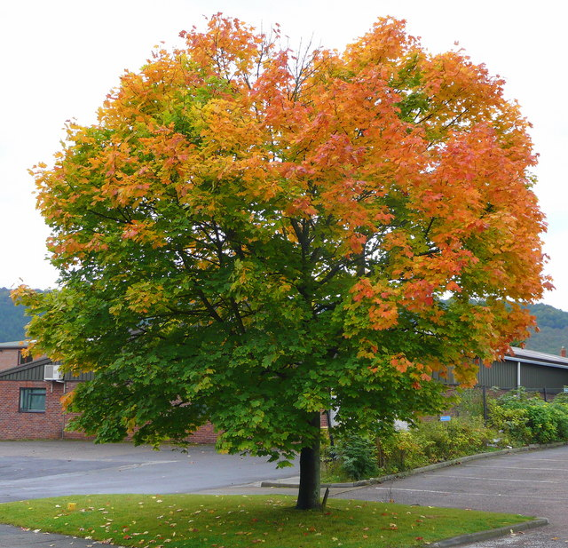
Diversity by Genus
Maples | 43.31%
Honeylocust | 15.24%
Sycamore/plane tree | 8.38%
Elm | 5.44%
Basswood/linden | 5.32%
Oak | 4.46%
Ash | 4.32%
Pear | 1.93%
Mulberry | 1.55%
Hackberry | 1.49%
This Photo by Unknown Author is licensed under CC BY-SA
Notes:
Here is a break-up of tree diversity by genus in Detroit’s street tree population
Maple is the most common genus in the region, making up over 43% of all tree species.
Next is honey locust at 15%, followed by sycamore at 8%, elm and basswood at about 5%, oak and ash at about 4%, and pear, mulberry, and hackberry all under 2%.
As we noted before, some maple species such as Norway, silver, and sugar maple are more vulnerable to increasing temperatures. In addition, if a pest that prefers maples, such as Asian longhorned beetle comes through, that could make the area especially vulnerable.

Slide 49
Adaptive Capacity of Urban Forests: Human Factors
Organizational
Plans, policies
Trained, sufficient staffing
Economic
Budgets
Ability to get grants
Social
Community support
Volunteer base
Notes:
In urban environments, adaptive capacity is complex and is based on several major themes – organizational, economic, and social.
The organizational theme includes things like plans and policies as well as trained and sufficient staff.
The economic theme includes things like budgets and the ability to receive grants.
The social theme includes things like community support and having a volunteer base.

Slide 50
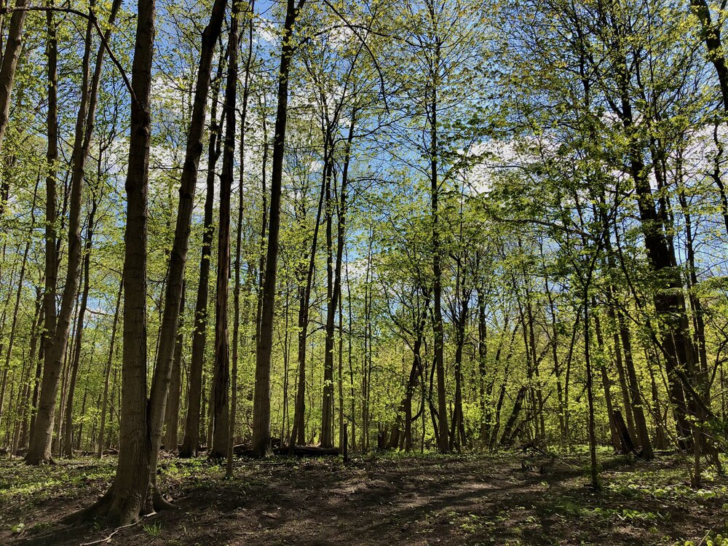
Key Points
See the forest, not just the trees!
When assessing impacts, consider physical, biological, and human-influences factors
Local factors like heat islands, impervious surface, pathogens, and invasive species can affect your urban forest’s vulnerability
Adaptive capacity is affected by not just your tree cover and diversity, but also social, organizational, and economic factors
Notes:
To recap, there are a variety of factors that are important to consider when it comes to the overall vulnerability of the urban forest including physical, biological, and human-influence factors in addition to local factors such as heat islands, impervious surfaces, pathogens, and invasive species.
Adaptive capacity is affected by tree cover and diversity, but it’s also affected by social, organizational, and economic factors.
A major takeaway here is to see the entire forest and the interacting factors, and not just the trees!
Now we will open it up for any questions you might have for Leslie and I

Slide 51

Questions?

Slide 52
For Tomorrow
Same time, same connection
We’ll be focusing on adaptation strategies
Panel on adaptation actions
Time to connect with other participants in small groups

Slide 53
End Day 1

Slide 54
Day 2

Slide 55
Adapting to Climate Change
Leslie Brandt
Northern Institute of Applied Climate Science

Slide 56
Today’s Objectives
Understand the concepts of resistance, resilience and transition
Become aware of tools for climate change adaptation planning
Learn what others are doing to adapt to changes in the region
Share your ideas with others

Slide 57
Today’s Agenda
10:05 Adapting Urban Forests to Climate Change: Approaches for Action-Leslie Brandt
10:30 Adaptation examples panel presentations
11:00 Panel Q&A
11:30 Breakout groups
11:50 Close-out and next steps
12:00 Adjourn

Slide 58
Poll!

Slide 59
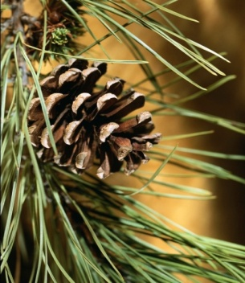
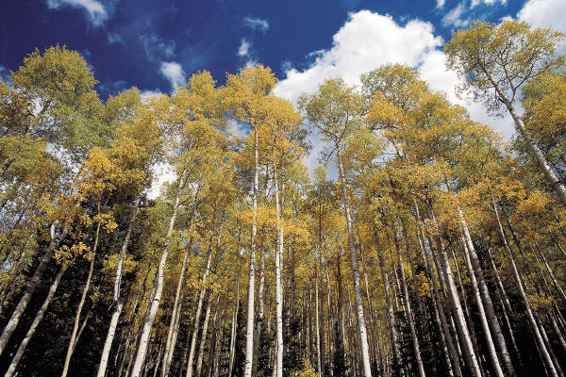


Adaptation
Adaptation is the adjustment of human or natural systems in response to climate change.
Parry et al. 2007, SCBD 2009, Groves et al. 2010

Slide 60
Adaptation
Adaptation is the adjustment of human or natural systems in response to climate change.
Adaptation activities can build on sustainable management, conservation, and restoration
Parry et al. 2007, SCBD 2009, Groves et al. 2010
Notes:
In a word, the choice is to adapt.
The upshot is the adaptation activities will build upon sustainable forest management and conservation IN MOST CASES. Much of what we’re already doing also makes good sense as a response to climate change.

Slide 61
Adaptation Options
Resistance
Resilience
Transition
persistence
Autonomous change
directed
change
See: Millar et al. 2007, Fisichelli et al. 2016
Notes:
How do you take these broad concepts and apply them to a real project?

Slide 62

https://www.vibrantcitieslab.com/guides/climate-health-action-guide/
Notes:
Today, I’m going to focus on the new climate and health action guide developed for the vibrant cities lab website. You can access it through this link.

Slide 63
Who is the Action Guide for?
Urban/community foresters
Public health professionals
Climate/sustainability professionals
Planners
Landscape architects
Notes:
Who is the action guide for? The action guide is designed for a variety of audiences including

Slide 64

Notes:
The action guide works in 5 main steps to develop a set of actions you can take to meet your urban forestry project goals while addressing human health and climate change challenges.

Slide 65
Urban Forestry Climate & Health Menu
CONCEPT
Strategy: A strategy is a broad adaptation response that is applicable across a variety of resources and sites
Approach: An approach is an adaptation response that is more specific to a resource issue or geography
Tactic: The most specific adaptation response, providing prescriptive direction about actions that can be applied to specific situations
ACTION
Undergoing review. Anticipated winter/spring 2021!
Notes:
The menu is organized with 9 broad strategies and 34 approaches. To give you a sense of the menu, I will describe broadly each of the strategies in the menu. This will give you a sense of the breadth of topics that we cover and some ideas about the relationship of forests, climate and human health.
I'll share a draft list of the strategies and approaches with you. If you would like to follow along using that as a handout you're certainly welcome too.
The complete menu document has descriptive paragraphs for each of the strategies and approaches that describe the rationale for them as well as the types of activities that would be undertaken for each strategy and approach . And then for each approach, we give examples of tactics that describe how the approach could be implemented. The tactics are meant to serve just as examples to get people thinking, because it tactics are infinite and we couldn't list all of them . We found that this structure is really helpful in terms of providing a robust review of the literature on the topic, as well as facilitating brainstorming. I hope it will be helpful to you in thinking about how to incorporate these issues into your planning.
This document is currently being reviewed for publication as a technical report by the USDA Northern Forest Climate Hub. We anticipate that we'll be able to have a final document ready for publication by this spring.

Slide 66


Strategy 1:
Engage social systems to integrate climate change, urban forest, and human health actions.
Adobe Stock
Notes:
The first two strategies are focused on human health.
The first strategy is really designed to take a holistic view of climate change and human health when undertaking any sort of planning activity. And so this conversation that we're having right here is a really good example of perhaps thinking beyond the bounds of sort of what we would typically do in terms of planning.
One of the things I really love about integrating climate change in human health into this new menu is it allows us to think about issues related to environmental justice and social equity. One of the approaches under the strategy is focused on addressing climate and health challenges of socially disadvantaged communities and vulnerable populations . And so an example of an action you might take would be thinking about how tree planting or green infrastructure projects that are intended to how big systems adapt changing climate conditions could be designed to facilitate community engagement and address disparities in parks and green spaces
Photo: Adobe photostock of Providence, RI from American Forests
.

Slide 67

Strategy 2:
Reduce the impact of human health threats and stressors using urban trees and forests.
Adobe Stock
Notes:
The second strategy is fairly straightforward in terms of using urban forests to reduce the impacts of climate change on human health. A really common and straightforward example of that is increasing urban tree cover. When we increase urban tree cover we can reduce the urban heat affect, improve air quality through the filtration capacity of trees, and allow for greater stormwater management through water infiltration and absorption.
The approach is in this strategy focus on: reducing extreme temperatures, improving Urban Air quality, and reducing the impact of hazardous weather and disturbance events
Photo: Adobe photostock of Providence, RI from American Forests

Slide 68




Strategy 3:
Maintain or increase extent of urban forests and vegetative cover.
Photos: Speak for the Trees Boston
Notes:
the next few strategies are really targeted towards urban forest reactions urban forestry actions, and these are updates of what was originally in the 2012 menu come on it give us a good chance to consolidate some of the approaches we had in the earlier menu , as well as think about the carbon benefits associated with these actions.
Strategy three is about maintaining and increasing the extent of urban forests and vegetative cover. This includes preventing forest loss and fragmentation or development other uses , as well as efforts to maintain the integrity of the current forest canopy and urban reforestation. This is a really fundamental approach for preserving the ability of urban forests and ecosystems to facilitate climate adaptation , as well as to maintain and increase carbon sequestered in urban forests

Slide 69

Strategy 4:
Sustain or restore fundamental ecological functions of urban ecosystems.
Strategy 5:
Reduce the impact of physical and biological stressors on urban forests.
Strategy 6:
Enhance taxonomic, functional, and structural diversity.
Photo: Guy Kramer
Notes:
I've got three really important strategies here that are all related to using that are all related to maintaining urban forest ecosystems and increasing their resilience to a variety of climate pressures. This includes sustaining and restoring fundamental functions of urban ecosystems , so that they are able to continue cleaning water and air , and buffering the impacts of climate change. Strategy 5 is about reducing the impacts of physical and biological stressors on urban forests, and addresses threats like extreme weather, invasive plant species, forest pests, and herbivory. Strategy 6 helps to increase the resilience of urban forests by increasing diversity in many different ways.
These strategies encompass a really wide array of urban forestry practices, and we have a number of adaptation demonstrations that provide examples of this type of work.

Slide 70

Strategy 7:
Alter urban ecosystems toward new and expected conditions.
Photo: Guy Kramer
Notes:
Is an urban forestry strategy that is more proactive in trying to anticipate future conditions and move systems towards those conditions. This strategy includes anticipatory adaptation actions such as encouraging and introducing new species, genotypes, and cultivars that are expected to be better adapted to future conditions. There are also strategies in this approach associated with revegetated and remediating sites after disturbance and using disturbance as a trigger to realign significantly change systems towards future conditions.

Slide 71

Strategy 8:
Promote mental and social health in the face of climate change.
Strategy 9:
Promote human health co-benefits in nature-based climate adaptation activities.
Adobe Stock
Notes:
The final two strategies are also focused on human health and there really designed to think about how nature spaces can promote health and healing in the face of climate change. Strategy 8 is really focused on promoting social and mental health for social cohesion, recognizing that climate change is a very stressful topic and we want communities that are able to come together and cope with the changes that we are experiencing and will continue to experience. strategy 9 looks at a smaller scale four opportunities to create Co benefits within the realm of other adaptation activities. So an example might be that if you had a green infrastructure project that was designed who address issues related to stormwater or flooding, you could design that more intentionally as a pocket park or greenspace that would enable people to also connect with nature because of the benefits of nature on human health

Slide 72
Workbook + Menu
Visit the Climate & Health Action Guide at
www.vibrantcitieslab.com
1. DEFINE location, project, and time frames.
5. MONITOR and evaluate effectiveness of implemented actions.
2. ASSESS site-specific climate change impacts and vulnerabilities
Vulnerability assessments and other resources
Adaptation Strategies and Approaches
(menu)
4. IDENTIFY adaptation approaches and tactics for implementation.
3. EVALUATE management objectives given projected impacts and vulnerabilities.
Notes:
I realize that was the briefest overview of the menu and it's really hard to do it justice to all of the interactions among these things . I hope you will take some additional time to look through the menu and think about how it relates to your work in the planning that you're doing is this group .
With my last few minutes I wanted to share a very brief example project just so you can see how this works with our adaptation workbook . We at NIACS use the adaptation workbook as part of plant project planning with a variety of stakeholders to incorporate climate change in a little work, and if this is something your organization is interested in please let us know.

Slide 73

Online Workbook
Adaptationworkbook.org

Slide 74

Examples!
https://forestadaptation.org/adapt/demonstration-projects
Notes:
So what does this look like in practice?
We at NIACS have been developing demonstration web pages that show real world examples of adaptation.

Slide 75

Speak for the Trees: Boston
Notes:
One example is speak for the trees, boston

Slide 76

I. Goals
Increase the tree canopy coverage, especially in under-canopied and under-resourced neighborhoods.
Goals for residential and multi-family residential properties:
  Give away 1000 trees to residents
  Educate Boston residents on the proper tree planting and care practices
  Implement follow-up engagement with residents who received trees
Notes:
For this project, their goals were to:

Slide 77
II. Impacts
Warmer temperatures and altered precipitation.
Insects and disease
The urban heat island effect exacerbating conditions
Impervious cover → heavy rain events
Transplanted trees are inherently more vulnerable

Slide 78
III. Challenges and Opportunities
Challenges
Opportunities
The urban heat island effect disproportionately impacts lower-resourced neighborhoods.
Trees planted by residents in private yards may have to endure some less-than-ideal patterns of soil moisture.
Trees planted by residents in private yards may struggle to survive with increased occurrences of invasive disease/pests.
A warming climate may allow for a broader range of species to be introduced to Boston's forest, increasing diversity.
Trees planted in residents' yards will likely have access to more soil moisture than street trees, especially during periods of less precipitation.

Slide 79

IV. Adaptation Strategies and Approaches
Residents' yards can serve as bridges for the urban canopy
Species that are likely to show resilience and hardiness will be selected
Tree species diversity will be prioritized

Slide 80

V. Monitoring
% trees planted after 2 weeks
% of trees that are given away that are eventually planted
Long-term communication with participants
% survival

Slide 81
Adaptation: Key Points
Adaptation options are on a spectrum from managing for persistence to managing for change
Adaptation workbook and menu provide an organizing framework to select adaptation options that will reduce vulnerability while achieving your management goals
Other cities are using the workbook and menu
  One size does not fit all
  Managers can pick and choose from the menu
  Can be a mix of resistance, resilience, and transition strategies

Slide 82
Breakouts
Briefly introduce yourselves, and discuss:
What climate change challenges are you seeing in your work?
What actions have you already taken to adapt to those changes?
What additional adaptation actions are you considering?
Record your answers at: https://forms.gle/nA17qvMQXjB9uo658
~20 minutes

Slide 83
Poll!

Slide 84
Wrap-up & Next Steps
Complete workshop evaluation (also sent via email)
Visit https://forestadaptation.org/learn/training-and-workshops for future trainings and workshops
  Adaptation Planning and Practices Courses
Adaptation Workshop Participants (February 2-3) send Step 1 to amrutled@mtu.edu and review materials
Let us know if you need continuing education credits
Thank you for participating!
Notes:
Those who are registered for week 1 only will receive a quick workshop evaluation via email and we greatly appreciate any feedback we receive from those so we can make improvements to future sessions
Also want to encourage you to visit Forest Adaptation website to keep a look out for future trainings and workshops.
If you’re interested in going more in depth on a planning project, we have various adaptation planning and practices courses, including an upcoming one for recreation professionals starting in April.
For participants who are registered for the adaptation workshop next week, this is just a reminder to complete step 1 before coming to the workshop and send that back to me beforehand, and please review the materials as well.
Thank you all for joining us!

Slide 85
Leslie Brandt
leslie.brandt@usda.gov
Annamarie Rutledge
amrutled@mtu.edu
Notes:
- Contact information for any questions

