Slide 1

Climate Change and the
Chequamegon-Nicolet National Forest
Kidrick Project
Stephen Handler
July 2020

Slide 2
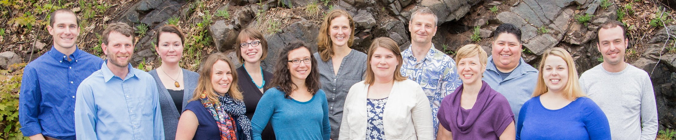






Northern Institute of Applied Climate Science
Chartered by USDA Forest Service, universities, non-profits, and tribal organizations:
Practical information on climate adaptation and carbon management
Adaptation resources
Technical assistance
www.NIACS.org
Notes:
NIACS = Northern Institute of Applied Climate Science
What is NIACS? Hybrid organization focused on climate, carbon and bioenergy projects
Getting knowledge into practice and action!
A collaborative approach among federal and non-federal organizations
The Northern Institute of Applied Climate Science (NIACS) has been designed as a collaborative effort among the Forest Service, universities, and forest industry to provide information on managing forests for climate change adaptation, enhanced carbon sequestration, and sustainable production of bioenergy and materials. As a regional, multi-institutional entity, NIACS builds partnerships, facilitates research, and synthesizes information to bridge the gap between carbon and climate science research and the information and management needs of land owners and managers, policymakers, and members of the public.
Products
Synthesis products on climate change adaptation, carbon cycle science and management, and bioenergy production.
Seminars, workshops, webinars, and educational materials about climate change science, forest response, and management strategies for adaptation, mitigation, and carbon cycle science for land managers in the region.
Enhanced communication and collaboration between land managers, policy-makers, and scientists.

Slide 3
Two Key Questions
How might climate change affect the resources that I manage?
What management actions could help prepare for those effects?
Notes:
Climate change is real and we are already living with the effects. There is, and always will be, uncertainty about the future. But we know enough now to begin preparing. Climate change might not be the biggest threat to our forests, but it’s something that we all should stop and consider as we do our jobs and manage our woods.

Slide 4
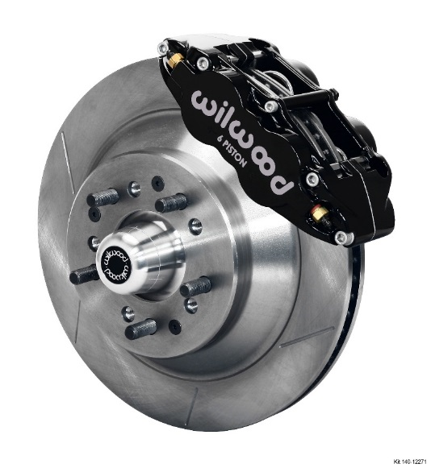

Twin concepts for responding to climate change
Mitigation = actions that reduce the human contribution to the greenhouse gas effect.
Adaptation = actions to prepare for and adjust to new conditions.
www.nca2014.gov

Slide 5
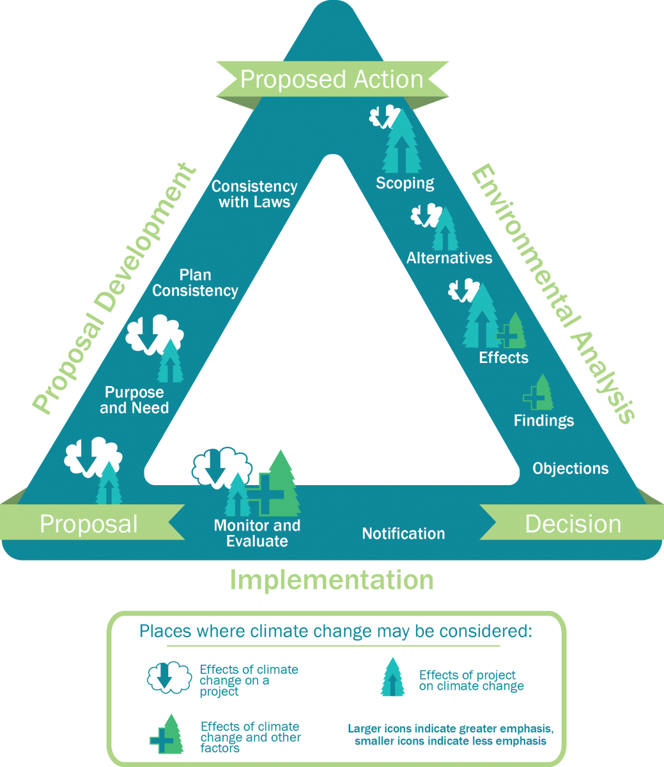
Climate Change and NEPA
Source: https://www.fs.usda.gov/ccrc/topics/nepa
Notes:
Many forest managers and landowners in Minnesota are wrestling with this information and making choices about how to adapt.
The upshot is that adaptation activities will usually build upon sustainable forest management and conservation. Much of what peple are already doing for smart forestry also makes good sense as a response to climate change.
This is something the CCRF is really focused on.

Slide 6
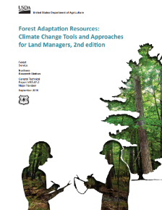
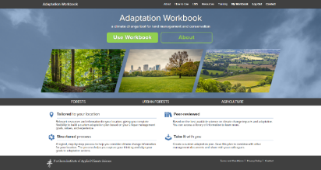
Forest Adaptation Resources
A flexible workbook and menu to address diverse needs
Designed for a variety of land owners with diverse goals
Does not make recommendations
Menu of adaptation strategies and approaches for forest management
Online version!
www.nrs.fs.fed.us/pubs/40543 and www.AdaptationWorkbook.org
Notes:
The Adaptation Workbook is described in another document here.
Again, this is not a set of recommendations about how everyone should respond.
It’s more like a set of key questions and a thought process that can lead to totally flexible, customized actions for climate adaptation.

Slide 7
Adaptation Workbook
1. DEFINE management objectives.
5. MONITOR and evaluate effectiveness.
2. ASSESS climate impacts.
4. IDENTIFY adaptation approaches.
3. EVALUATE management objectives.
Swanston and Janowiak 2012; www.nrs.fs.fed.us/pubs/40543
Notes:
Adaptation will be driven by individual goals, forest conditions, and site characteristics
It’s the first step of the process
One of the benefits – putting the whole thought process together. Documentation AND opportunities to be creative, identify win-win opportunities as well as new ideas on adaptation.

Slide 8
A systematic process…
Management Objectives | Challenges | Opportunities | Feasibility | Other Considerations
Adaptation Actions |  |  | Benefits | Drawbacks/ Barriers | Recommend Tactic?
Approach | Tactics | Time Frame

Slide 9

Intentional
Explicitly consider and address climate change
Sure we might get lucky…
Intentionally assessing risk and vulnerabilities makes our plans more robust!
Notes:
Choose your own adventure!

Slide 10

Flexible
Notes:
Choose your own adventure!

Slide 11

An Uncertain Future
Don’t wait for a crystal ball

Slide 12
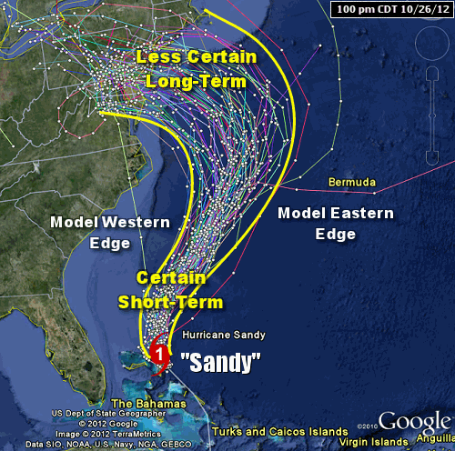
We Don’t Need Certainty
Instead: think about risk management!

Slide 13
Adaptation
Adaptation actions may not look that different from current management actions, especially in the near term.
Small “tweaks” that improve effectiveness
Same actions– climate change just makes them that much more important
New & different actions, even some that seem wild & crazy
Notes:
Many forest managers and landowners in Minnesota are wrestling with this information and making choices about how to adapt.
The upshot is that adaptation activities will usually build upon sustainable forest management and conservation. Much of what peple are already doing for smart forestry also makes good sense as a response to climate change.
This is something the CCRF is really focused on.

Slide 14
Adaptation Options
Resistance
Reduce impacts / Maintain current conditions
Manage for Persistence:
Ecosystems are still recognizable as being the same system (character)
Resilience
Transition
Manage for Change:
Ecosystems have fundamentally changed to something different
Forward-looking/Promote change
Notes:
Adaptation ideas – or concepts
There are three different options that are helpful for thinking about climate change adaptation: resistance, resilience, and transition. Resistance and resilience emphasize management for the persistence of existing systems, and transition promotes system change.
These actions reside as a continuum of choice in how to respond
Know where you are going – general direction you are heading – at the intersection – going left, straight or right
Resistance - Reduce impacts/ Maintain current conditions
Resilience –
Transition - Forward-looking/ Promote change – Innovation!

Slide 15
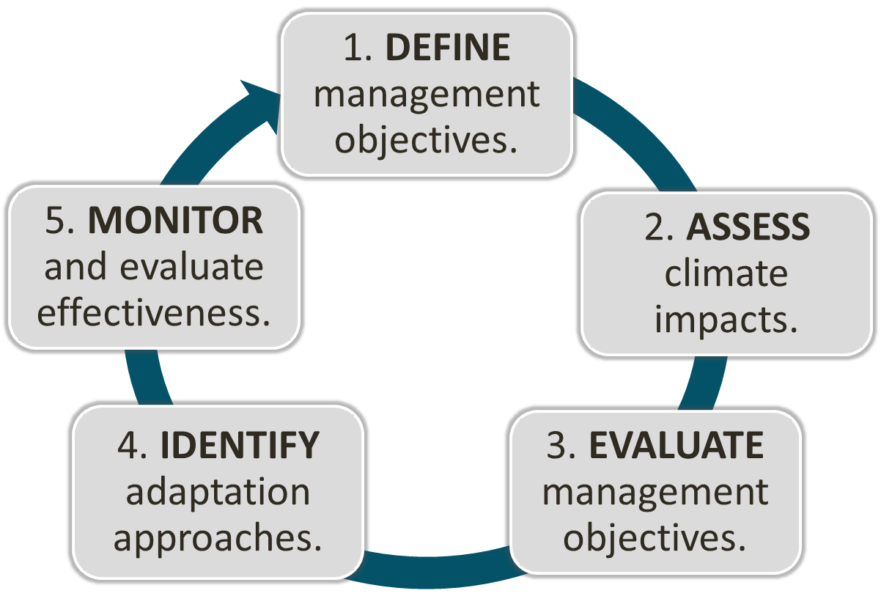

Adaptation Workbook
A workbook process provides “structured flexibility”
Menu
www.nrs.fs.fed.us/pubs/40543 and www.AdaptationWorkbook.org
Notes:
Adaptation will be driven by individual goals, forest conditions, and site characteristics
It’s the first step of the process
One of the benefits – putting the whole thought process together. Documentation AND opportunities to be creative, identify win-win opportunities as well as new ideas on adaptation.

Slide 16
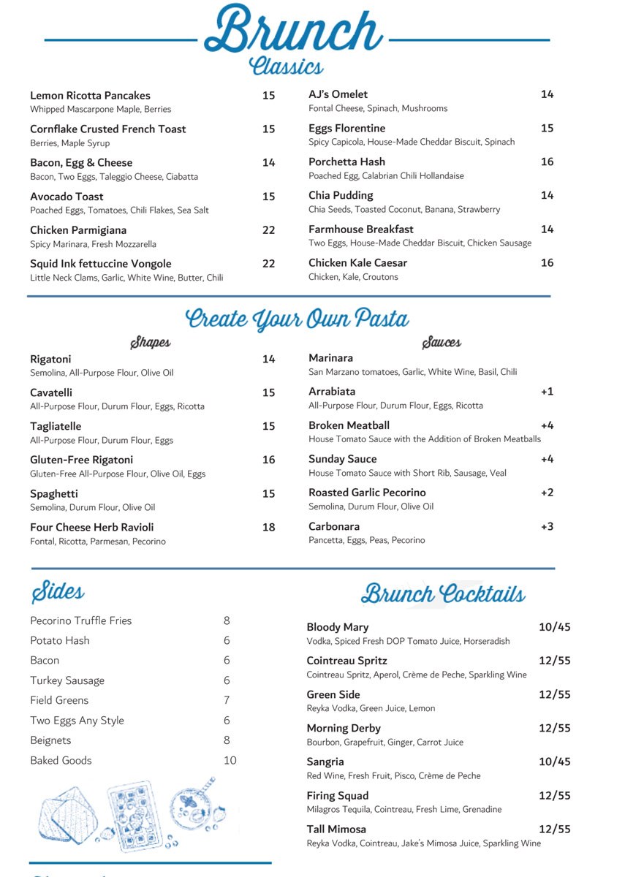
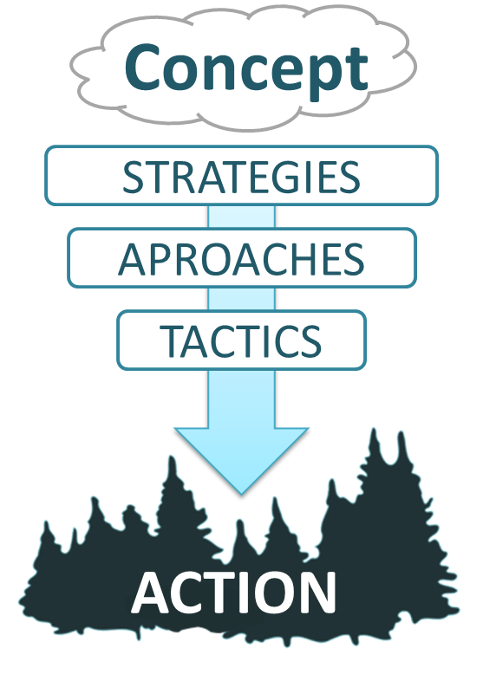
Adaptation Menus
A collection of plausible adaptation actions that is:
Specific to a discipline
Organized into a tiered hierarchy
Thorough and comprehensive (including opposing ideas!)
www.nrs.fs.fed.us/pubs/40543 and www.AdaptationWorkbook.org

Slide 17
Adaptation Menu Benefits
Address challenges in implementing adaptation:
Connecting broad ideas to specific actions
Making actions intentional
Communicating your ideas
Boosting creativity
www.nrs.fs.fed.us/pubs/40543 and www.AdaptationWorkbook.org

Slide 18
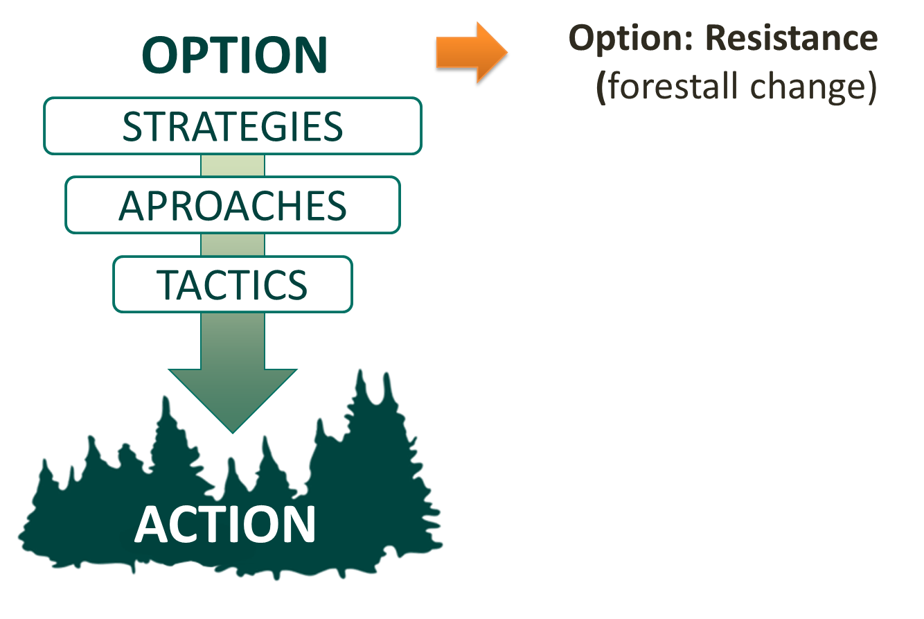
Adaptation Menus
1. Connecting Broad Ideas to Specific Actions
www.nrs.fs.fed.us/pubs/40543 and www.AdaptationWorkbook.org

Slide 19
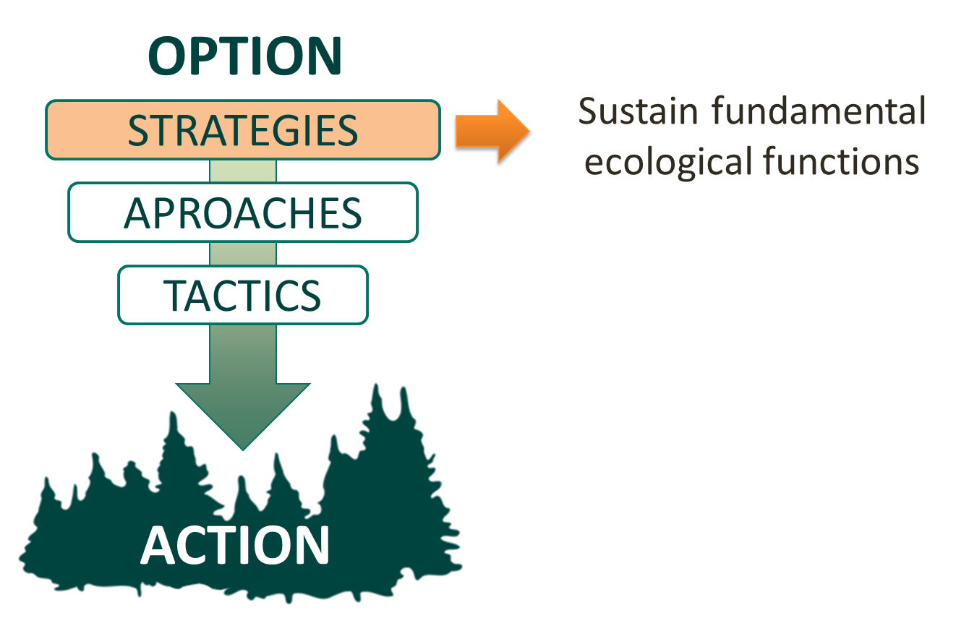
Adaptation Menus
1. Connecting Broad Ideas to Specific Actions
www.nrs.fs.fed.us/pubs/40543 and www.AdaptationWorkbook.org

Slide 20
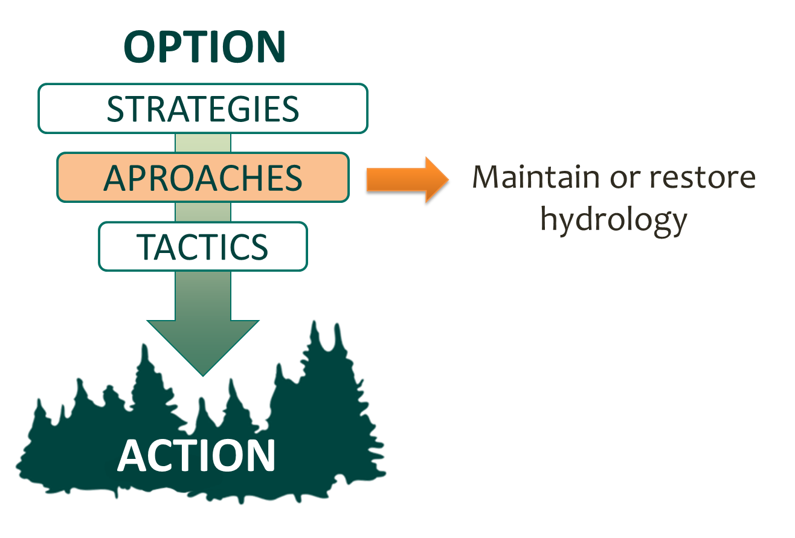
Adaptation Menus
1. Connecting Broad Ideas to Specific Actions
www.nrs.fs.fed.us/pubs/40543 and www.AdaptationWorkbook.org

Slide 21
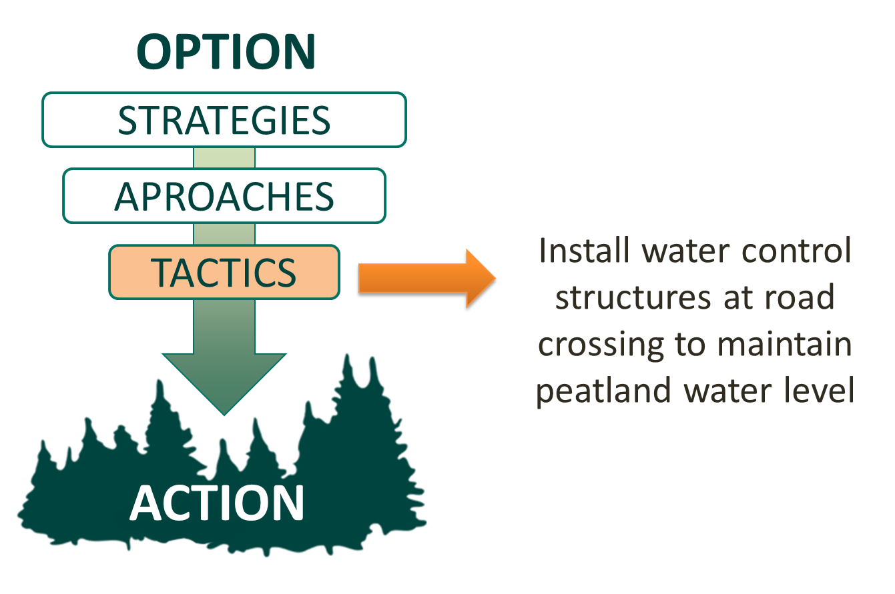
Adaptation Menus
1. Connecting Broad Ideas to Specific Actions
www.nrs.fs.fed.us/pubs/40543 and www.AdaptationWorkbook.org

Slide 22
Adaptation Menus
2. Making Actions Intentional
My goal is to ….
(Options and Strategies)
So I will ….
(Approaches and Tactics)
www.nrs.fs.fed.us/pubs/40543 and www.AdaptationWorkbook.org

Slide 23
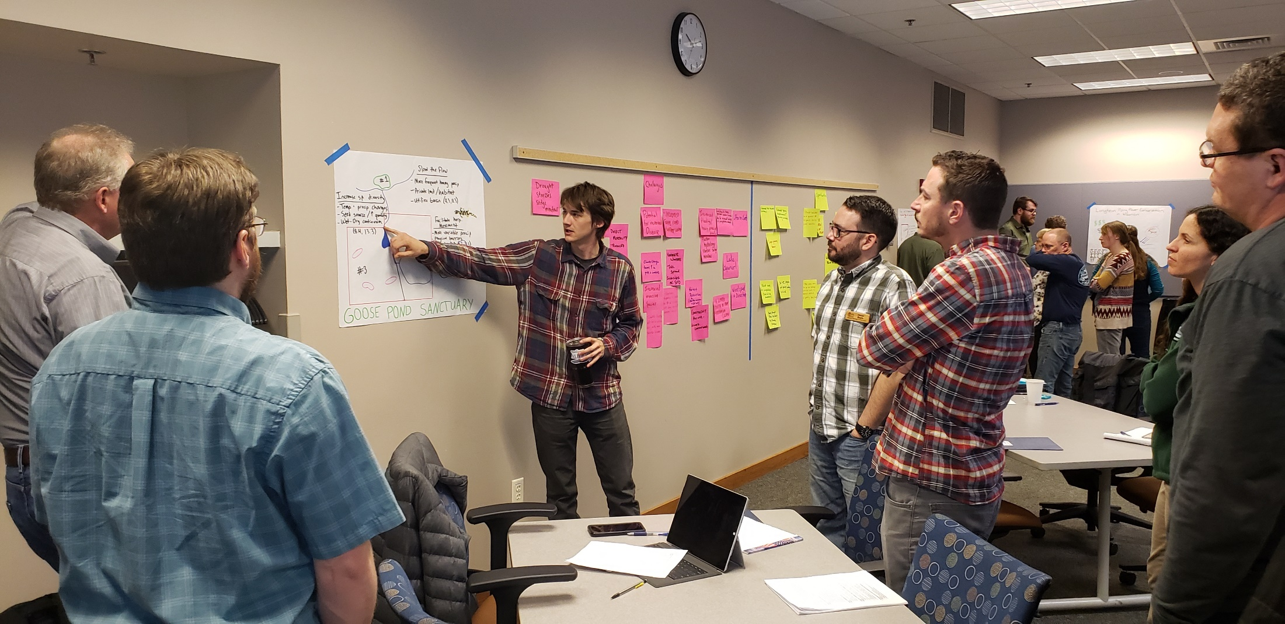
Adaptation Menus
3. Communicating your Ideas
wwww.forestadaptation.org

Slide 24
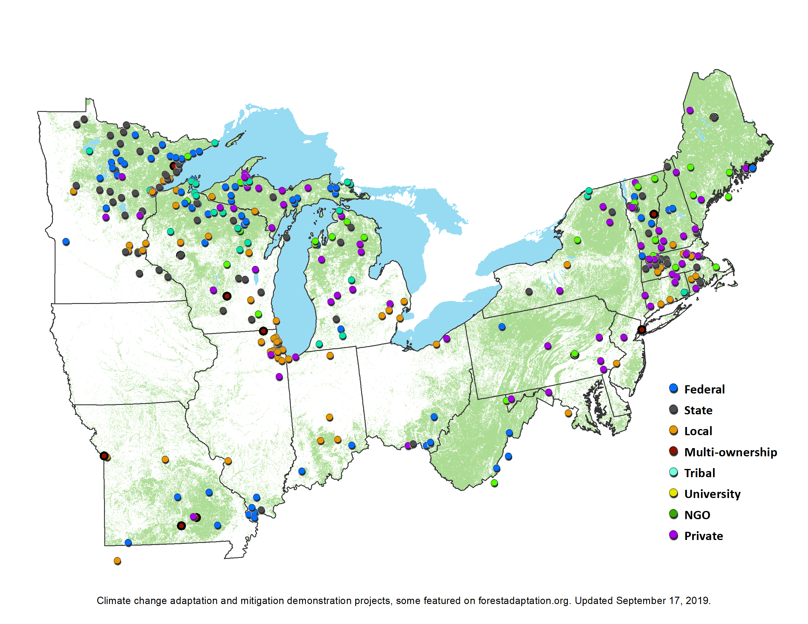
Adaptation Menus
3. Communicating your Ideas
wwww.forestadaptation.org

Slide 25

Adaptation Menus
4. Boosting Creativity
wwww.forestadaptation.org

Slide 26


A Growing Collection
Published:
Forestry
Urban Forestry
Agriculture
Forested Watersheds
Tribal Perspectives
Forest Carbon Management
Recreation
Non-forested Wetlands
Glacial Lakes Fisheries
In Preparation:
Wildlife Management
Coastal Ecosystems
Grasslands
Fire (western?)
Mix and Match:
Menus can be used independently or together in a single project!
www.forestadaptation.org/adapt/adaptation-strategies

Slide 27
Gameplan for Kidrick

Slide 28
Adaptation Workbook
1. DEFINE management objectives.
5. MONITOR and evaluate effectiveness.
2. ASSESS climate impacts.
4. IDENTIFY adaptation approaches.
3. EVALUATE management objectives.
Swanston and Janowiak 2012; www.nrs.fs.fed.us/pubs/40543
Notes:
Adaptation will be driven by individual goals, forest conditions, and site characteristics
It’s the first step of the process
One of the benefits – putting the whole thought process together. Documentation AND opportunities to be creative, identify win-win opportunities as well as new ideas on adaptation.

Slide 29
Adaptation Workbook
On your own (or in resource area groups)
1. DEFINE management objectives.
5. MONITOR and evaluate effectiveness.
2. ASSESS climate impacts.
4. IDENTIFY adaptation approaches.
3. EVALUATE management objectives.
Swanston and Janowiak 2012; www.nrs.fs.fed.us/pubs/40543
Notes:
Adaptation will be driven by individual goals, forest conditions, and site characteristics
It’s the first step of the process
One of the benefits – putting the whole thought process together. Documentation AND opportunities to be creative, identify win-win opportunities as well as new ideas on adaptation.

Slide 30
Adaptation Workbook
On your own (or in resource area groups)
Session 2
1. DEFINE management objectives.
5. MONITOR and evaluate effectiveness.
2. ASSESS climate impacts.
4. IDENTIFY adaptation approaches.
3. EVALUATE management objectives.
Swanston and Janowiak 2012; www.nrs.fs.fed.us/pubs/40543
Notes:
Adaptation will be driven by individual goals, forest conditions, and site characteristics
It’s the first step of the process
One of the benefits – putting the whole thought process together. Documentation AND opportunities to be creative, identify win-win opportunities as well as new ideas on adaptation.

Slide 31
Step 1 Prep
Write down your key management goals and objectives for your resource area!
Resource Areas | Goals (Made-up examples…) | Objectives
Wildlife | Increase large red and white pine for eagle nest sites Prevent brush encroachment into marshes Restore waterfowl habitat and wild rice production within Summit and Cyrus lakes | How/ where/ how much?
Vegetation/ Silviculture | Increase the amount of young forest Improve forest diversity in aspen stands Expand an mature spruce-fir forest patch | How/ where/ how much?
Water resources | Maintain coldwater trout habitat Correct AOP barriers | How/ where/ how much?
www.forestadaptation.org

Slide 32
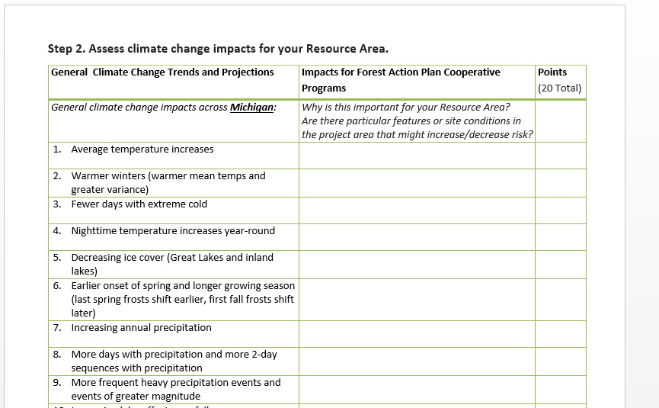
Step 2 Prep
Which climate change impacts are most important (positive or negative) for your resource area?
Are there particular features or conditions within the project area that might increase/decrease climate risk?

Slide 33
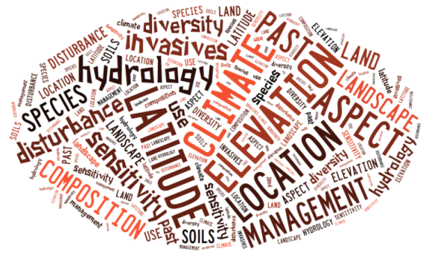
Regional to Site-Specific
Research and assessments describe broad trends but local conditions and management make the difference.

Slide 34
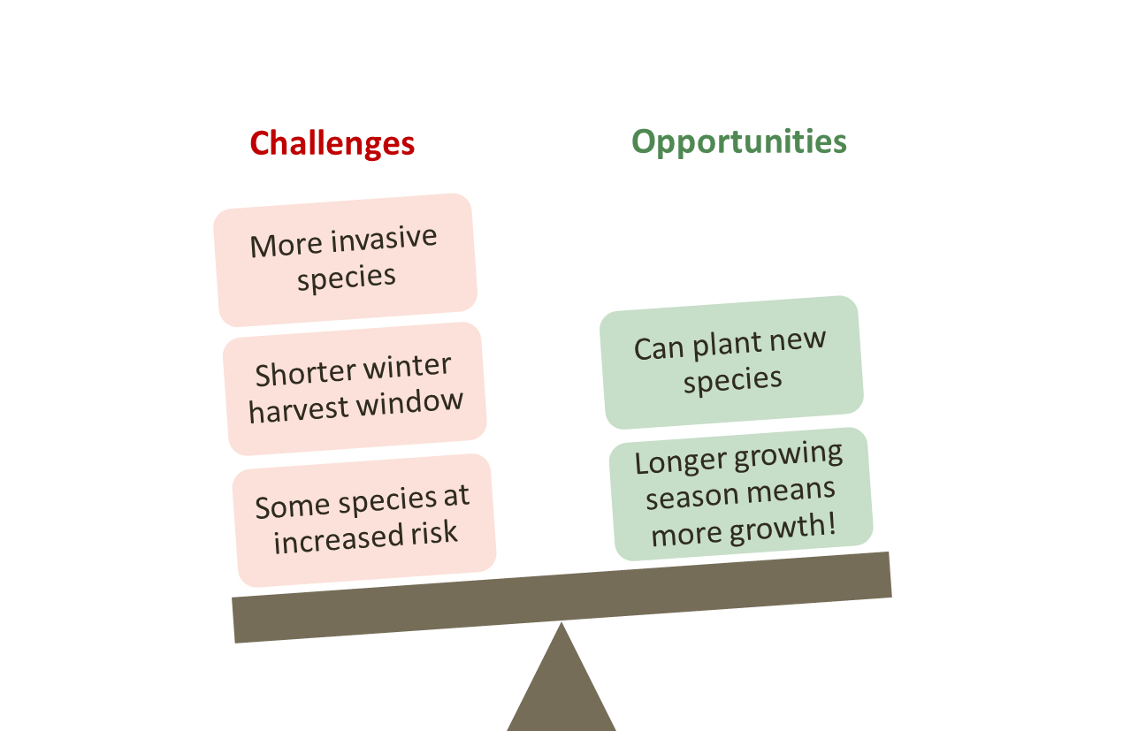
Step 3 Prep
Evaluate your management objectives (Step 1). Are they still feasible with current management (same management tactics, same investment of time and resources)?
Hold on to these ideas for our discussion.
Feasibility definitions:
Low – Current management may not overcome challenges. Extra resources or new efforts will be necessary.
Medium – Current management can likely overcome challenges. Extra resources may be necessary to counteract key challenges or promote new opportunities.
High – Current management actions can overcome the challenges presented by climate change. Opportunities outweigh challenges.

Slide 35
Next Steps
Stephen will send presentation and pre-work
Pre-work! (Send to Stephen and Leesha by 7/21.)
  List major Goals and Objectives for your resource area (Step 1)
  Complete climate change impacts worksheets for your resource area. (Step 2)
  Consider feasibility of your Objectives (Step 3)
  Review adaptation menus (optional)
Get in touch with questions!
Plan to meet for session 2!
www.forestadaptation.org

Slide 36
Adaptation Workbook
1. DEFINE management objectives.
5. MONITOR and evaluate effectiveness.
2. ASSESS climate impacts.
4. IDENTIFY adaptation approaches.
3. EVALUATE management objectives.
Swanston and Janowiak 2012; www.nrs.fs.fed.us/pubs/40543
Notes:
Adaptation will be driven by individual goals, forest conditions, and site characteristics
It’s the first step of the process
One of the benefits – putting the whole thought process together. Documentation AND opportunities to be creative, identify win-win opportunities as well as new ideas on adaptation.

Slide 37
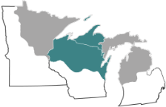
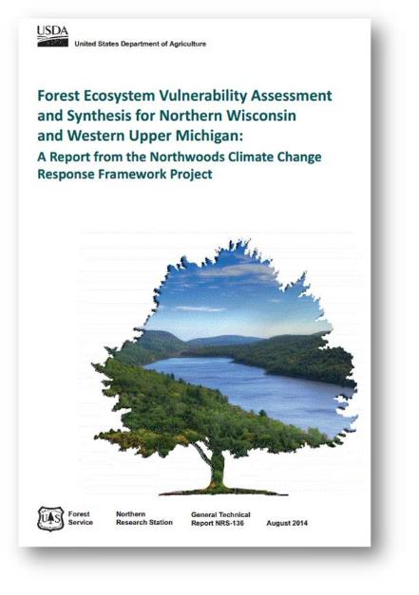
Climate Change Information
  Examine a range of future climates
  Do not make recommendations
  Sources of information:
    Models
    Published research
    Local managers and experts
Download: www.nrs.fs.fed.us/pubs/46393

Slide 38
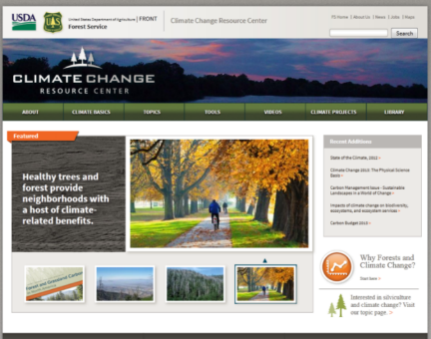
More Information
Climate Change Resource Center
http://www.fs.usda.gov/ccrc/

Slide 39
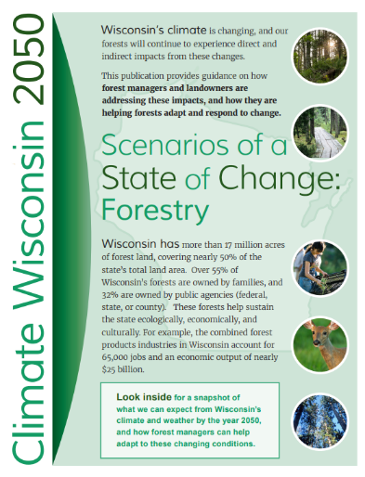
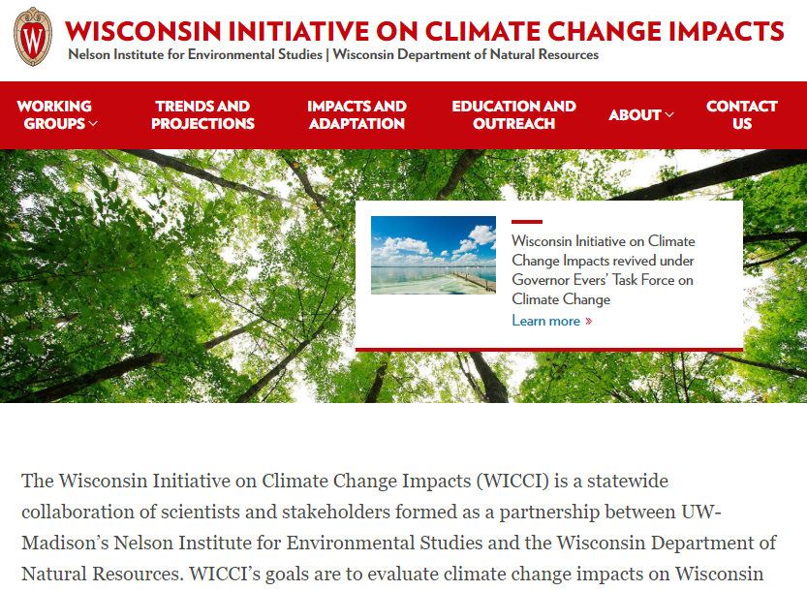
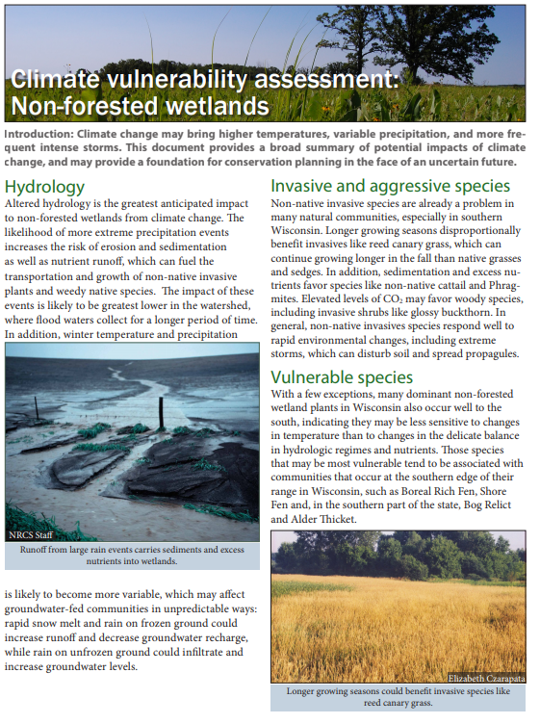
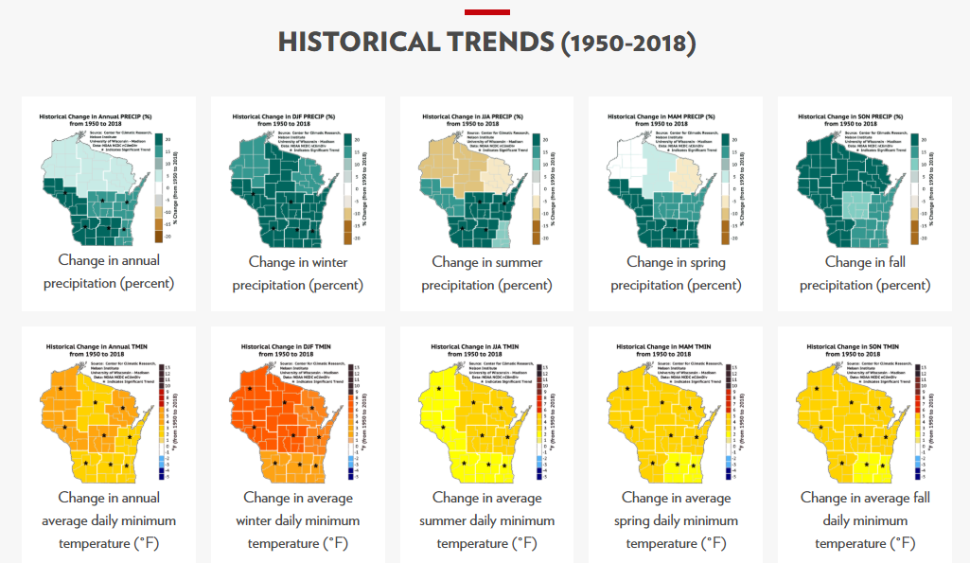
Even More Information…
  WICCI
  Public website
  Useful handouts
  Natural Community vulnerability assessments
  Links to climate maps, recorded presentations, and other info
https://www.wicci.wisc.edu/forestry-working-group.php

Slide 40
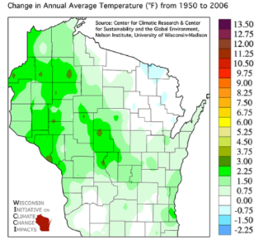
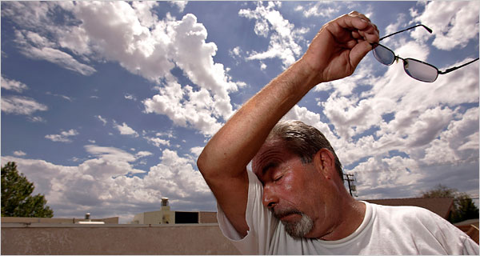
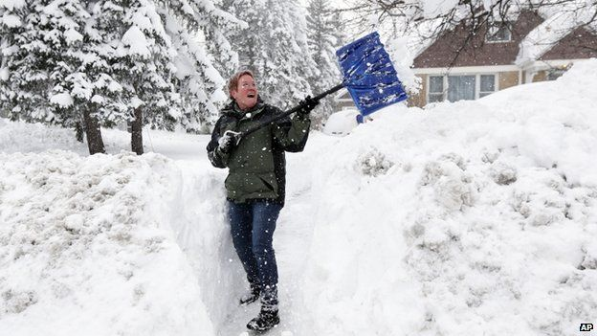
Climate vs. Weather
Notes:
Mood vs. Personality

Slide 41

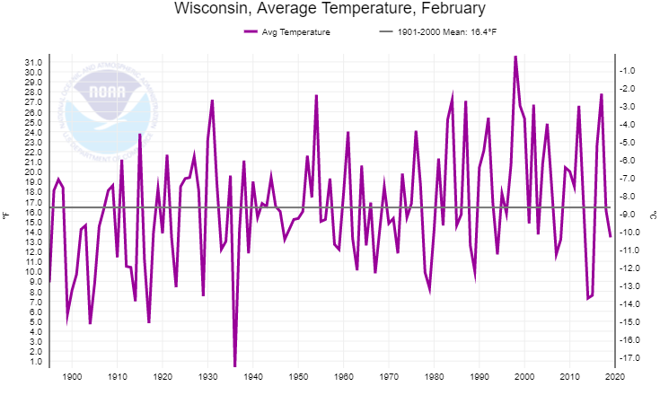
Weather
http://www.ncdc.noaa.gov/cag/time-series/us
http://www.ncdc.noaa.gov/cag/time-series/us
Notes:
High point – el nino 1997-1998.
Feb 2019 – 3 degrees below normal
Feb 2018 = -0.3, right about the average winter
FEB 2017 = +11.4, 2nd warmest
2016: +6.3, top 20 warmest
2015: -9, top 10 coldest
2014: -9, top 10 coldest
RED= warm
BLACK= cold

Slide 42
Weather + Time = Climate
http://www.ncdc.noaa.gov/cag/time-series/us
http://www.ncdc.noaa.gov/cag/time-series/us

Slide 43
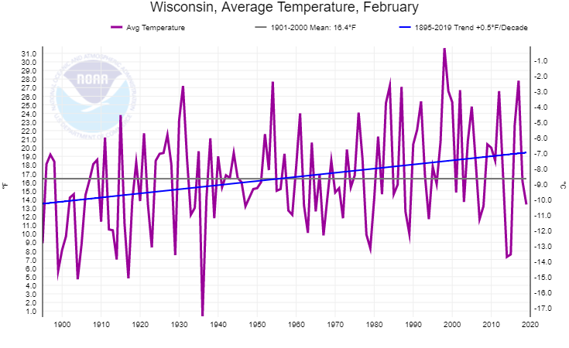
Climate Change
http://www.ncdc.noaa.gov/cag/time-series/us
Notes:
Warming 5F per century. Just for the month of Feb.

Slide 44
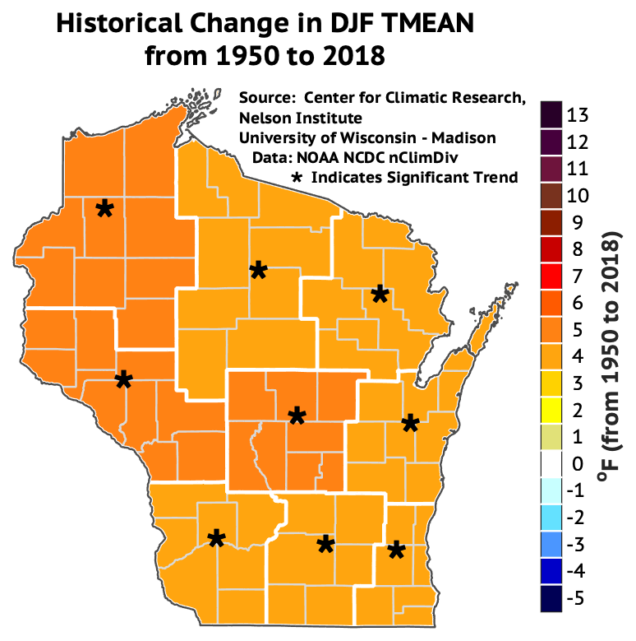
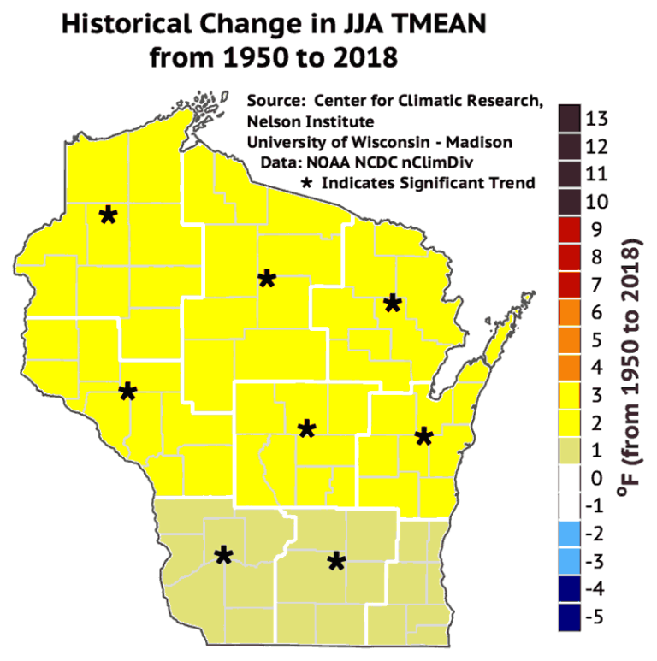
Temperature Change - Observed
Winter
Summer
Dan Vimont, WI-Madison

Slide 45
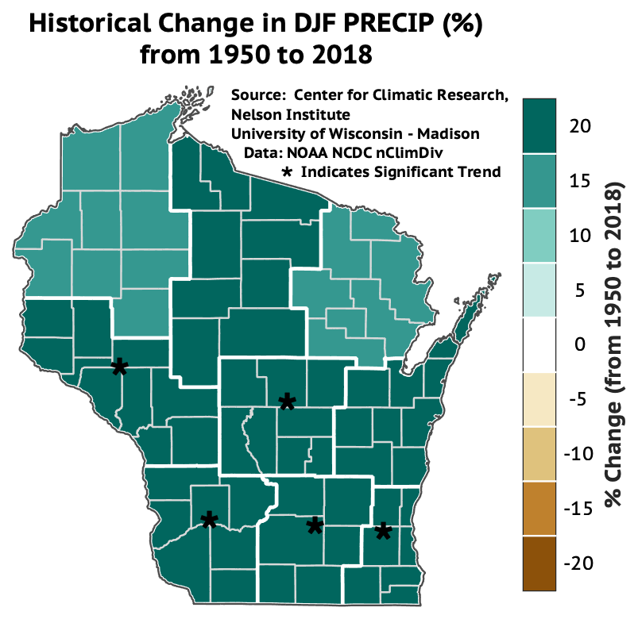
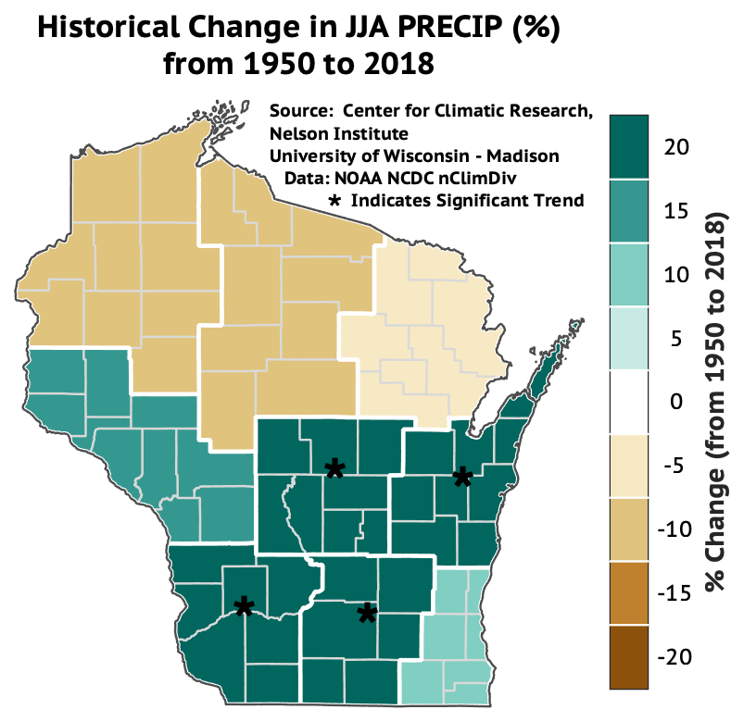
Precipitation Change - Observed
Winter
Summer
Dan Vimont, WI-Madison
Notes:
3.2 degrees = annual temp change from 1950-2017, compared to 1951-1980 baseline

Slide 46
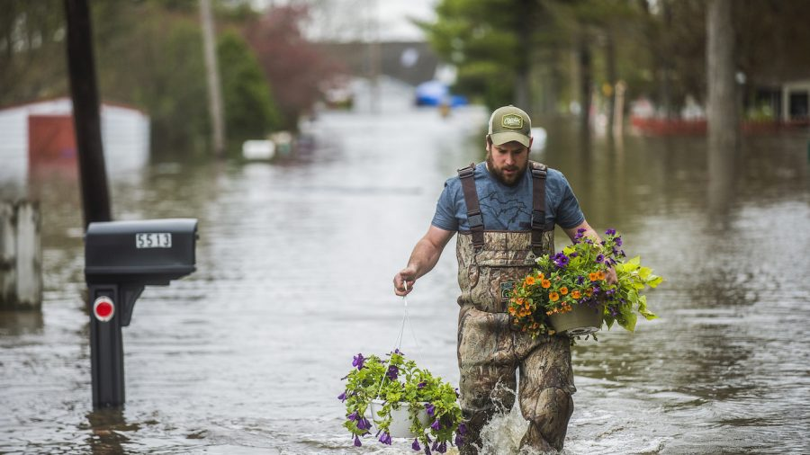
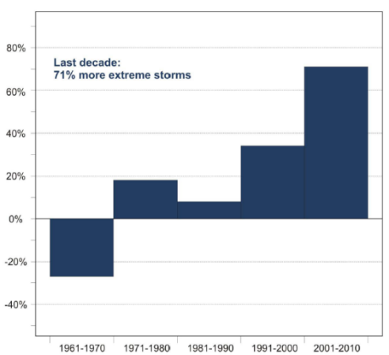
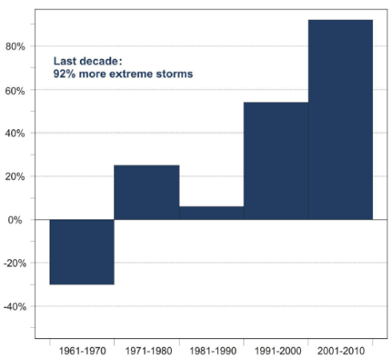
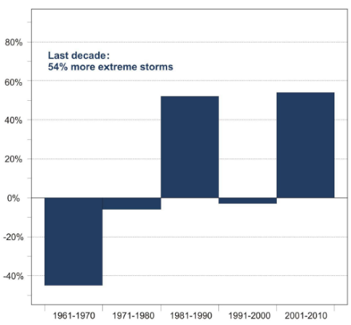
Heavy Precipitation - Observed
Large rain events (3”+) have become more frequent
Minnesota
Wisconsin
Michigan
Saunders et al. 2012
Notes:
For example, we have a lot of evidence that the hydrologic cycle is becoming more episodic, more precip is being delivered in intense storms. This figure looks at rainstorms of 3 inches or more across the whole state of MN for the past 50 years.
The trend is clear, and it’s something everyone in MN has probably experienced directly.

Slide 47
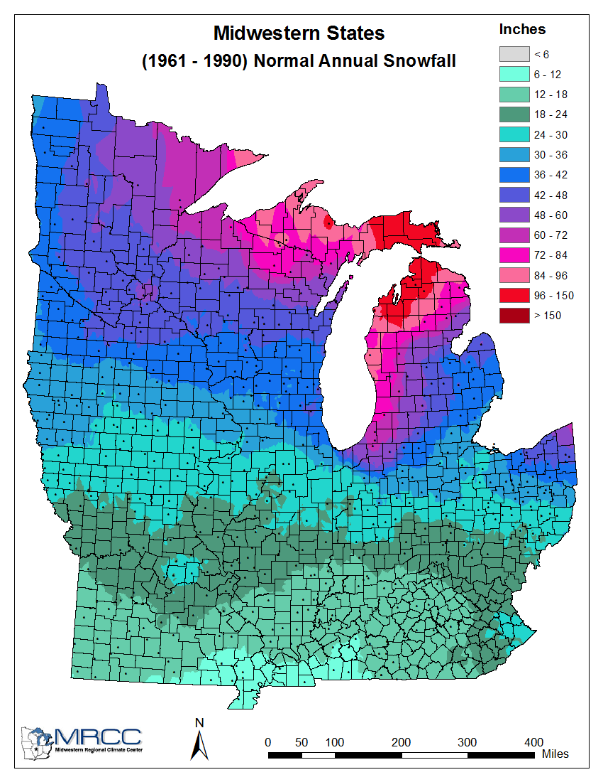
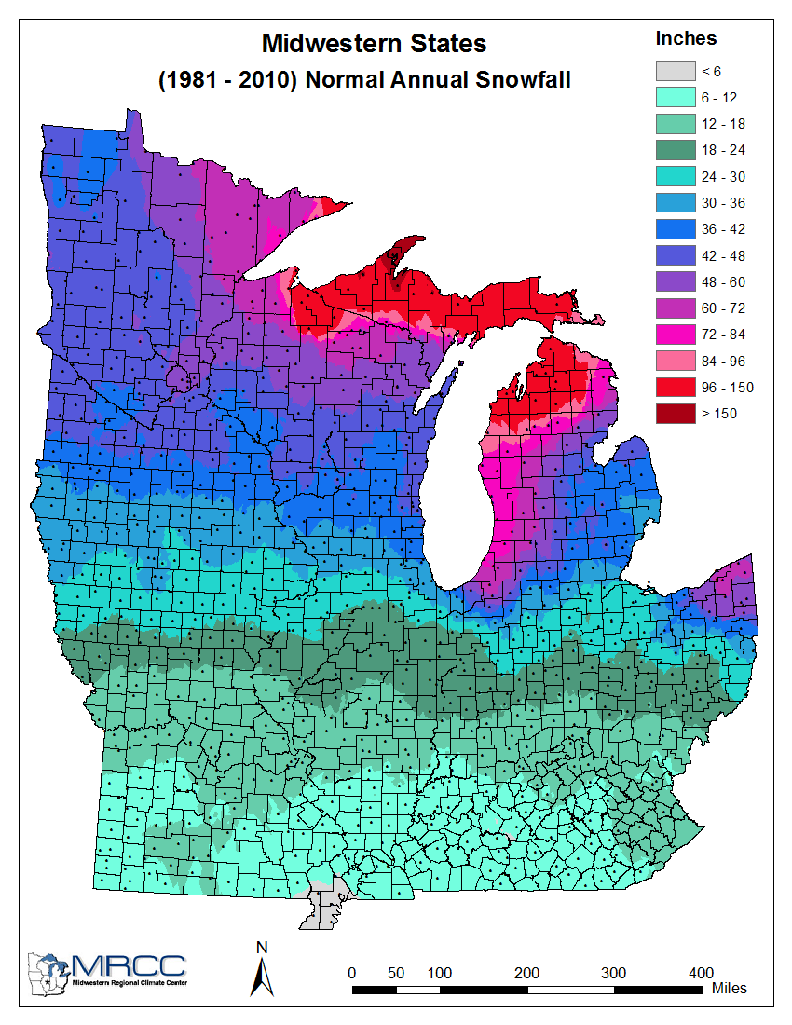
Snowfall - Observed
(Midwestern Regional Climate Center)

Slide 48
Future Climate Projections

Slide 49

Known Unknowns
Two main sources of uncertainty in climate projections:
Climate models
Future greenhouse gas emissions

Slide 50
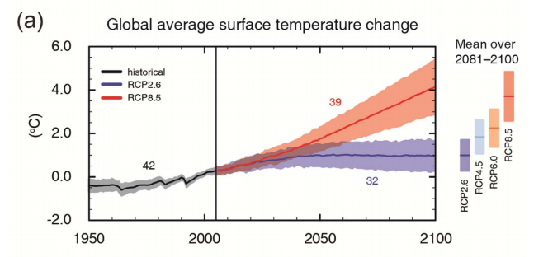
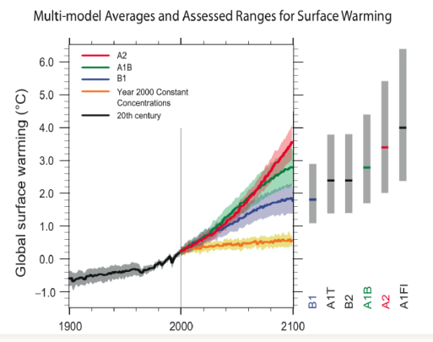
(IPCC, 2013)

Slide 51
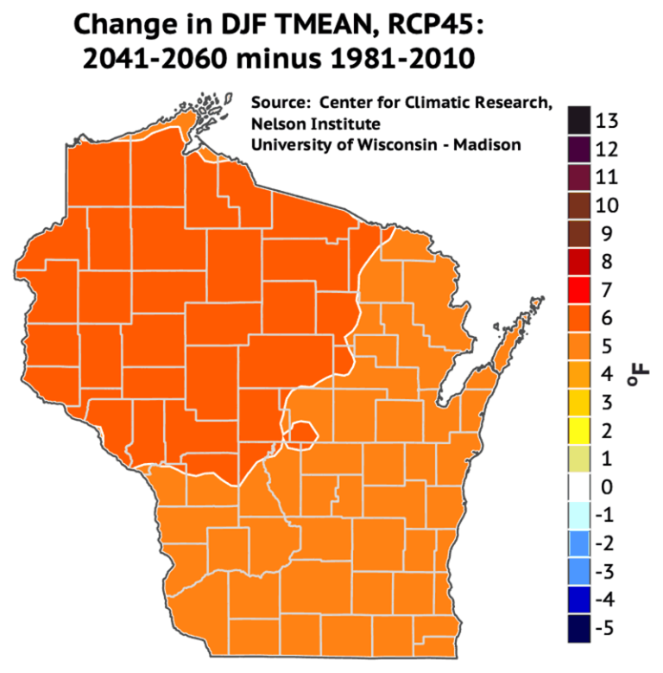
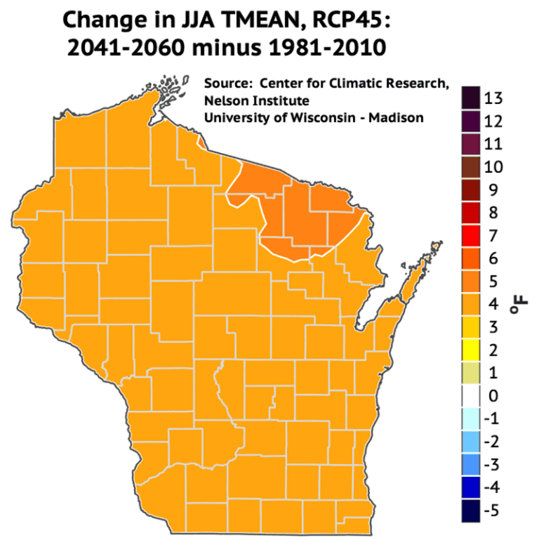
Temperature Change - Projected
Winter
Summer
Dan Vimont, WI-Madison

Slide 52
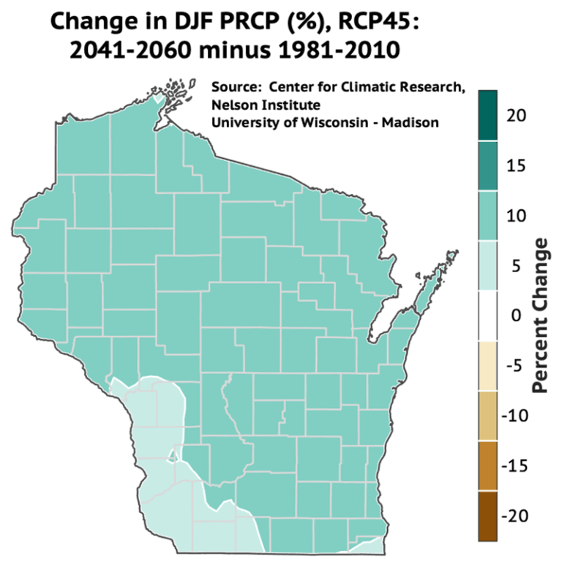
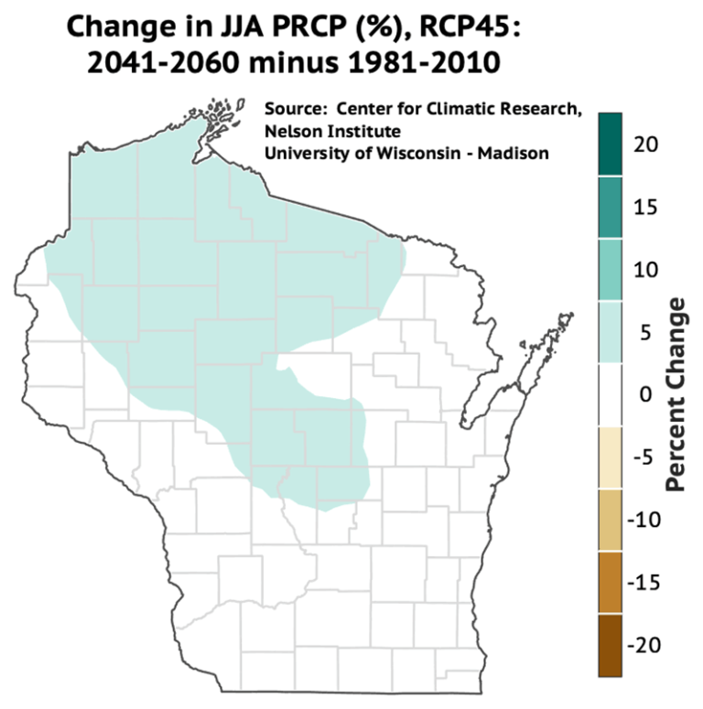
Precipitation Change - Projected
Winter
Summer
Dan Vimont, WI-Madison
Notes:
3.2 degrees = annual temp change from 1950-2017, compared to 1951-1980 baseline

Slide 53
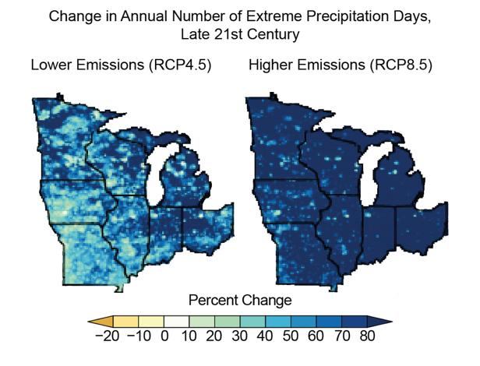
Extreme Rain Events
Liqiang Sun and Ken Kunkel, Cooperative Institute for Climate and Satellites

Slide 54
Winter Rain
Dynamically downscaled RCP 8.5
*Transition to rain, especially for Nov, Mar, April
Notaro et al 2015
Notes:
Winter Severity Index (WSI), relevant for white-tailed deer, based on frequency of days with 18"+ snow depth on ground and minimum temperature less than 0F.

Slide 55
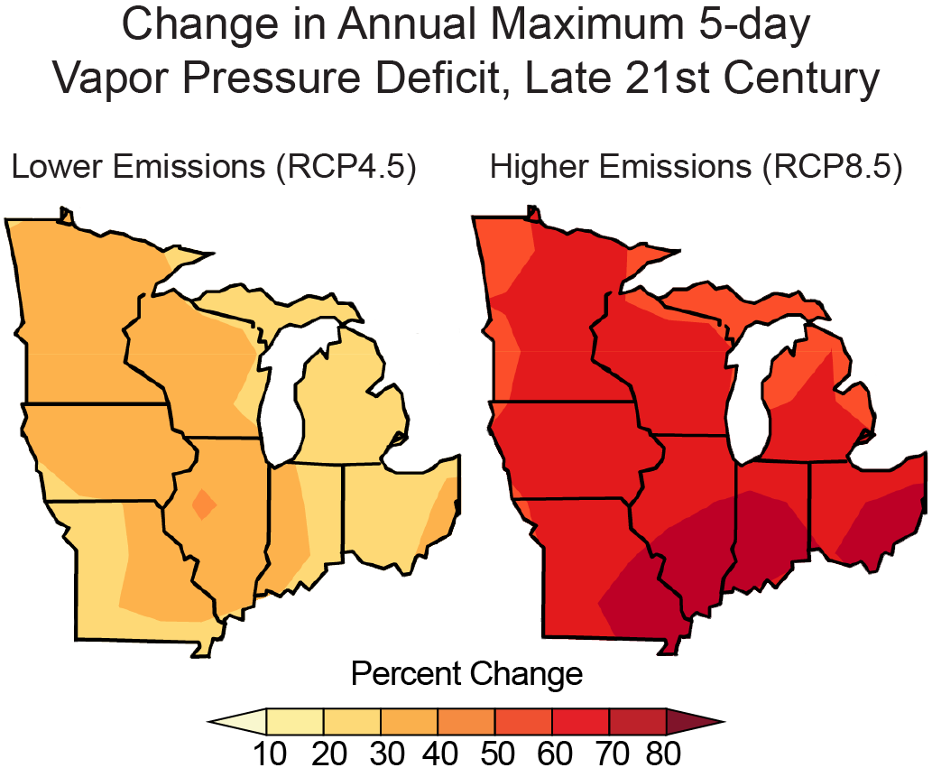
More Drought Stress
Liqiang Sun and Ken Kunkel, Cooperative Institute for Climate and Satellites

Slide 56
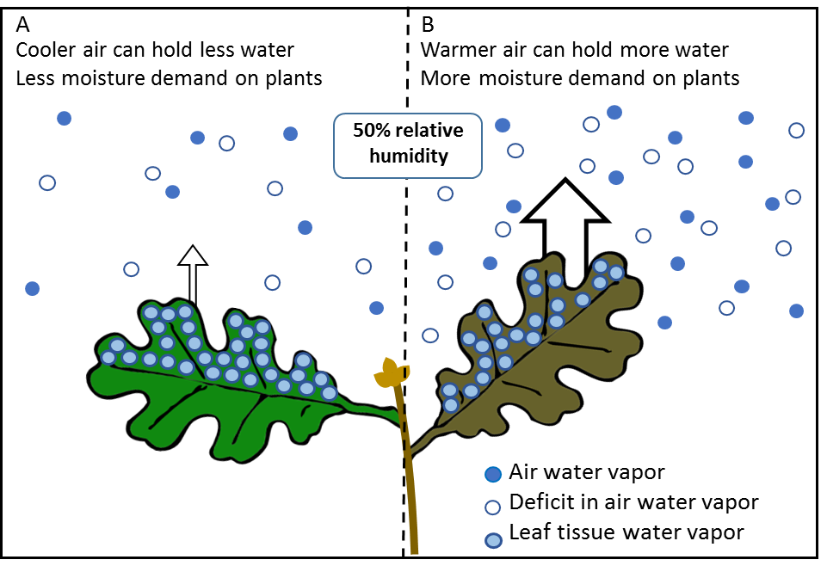
More Drought Stress
Notes:
FIGURE CAPTION: Impacts of projected changes to vapor pressure deficit (VPD) on the drying effect of air on plants and soils. (A) Cooler air can hold less moisture than (B) warmer air. At the same relative humidity (e.g., 50% air saturation), warmer air has more demand on leaf water from the greater deficit in water vapor in air. (C) Change in the moisture deficit of the air based on projected maximum five-day VPD by the late 21st Century for low and high emissions.

Slide 57

More Drought Stress
Greater uncertainty about future precipitation, but great risk of summer moisture stress
Water loss from trees (transpiration)
Precipitation
Intense precipitation
Water loss from soils (evaporation)
Runoff
Groundwater recharge

Slide 58
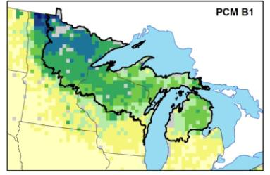


Species Range Shifts
2070-2100 Low
Quaking Aspen
Current
Importance Value
Low
2070-2100 High
High
www.fs.fed.us/nrs/atlas/
Source: Louis Iverson et al. (US Forest Service)
Notes:
These are samples – much more in Ch 5 of vulnerability assessment
Paper birch 0.87 to 0.23 Lg. Dec.

Slide 59



Species Range Shifts
2070-2100 Low
White Oak
Current
Importance Value
Low
2070-2100 High
High
www.fs.fed.us/nrs/atlas/
Source: Louis Iverson et al. (US Forest Service)
Notes:
These are samples – much more in Ch 5 of vulnerability assessment
Paper birch 0.87 to 0.23 Lg. Dec.

Slide 60

Species Range Shifts
Handouts for many different regions:
Northern MN
Northern WI & western UP
Eastern UP & northern LP
Driftless Area
Southern WI
Southern MI
Source: Louis Iverson et al. (US Forest Service)
www.forestadaptation.org/Northwoods_treehandouts
Notes:
These are samples – much more in Ch 5 of vulnerability assessment
Paper birch 0.87 to 0.23 Lg. Dec.

Slide 61


Pests and Diseases
Climate change can trigger more damage from pests.
Ray Grumney, Star Tribune. Photo: Fraser McKee

Slide 62

Wildfire Risk
Fire may increase, because:
Warmer/drier summers
Increased mortality from stress, pests, events
More frequent weather conditions that promote large fires
FWI = Fire Weather Index values
Guyette et al. 2014, Tang et al. 2014, Miranda et al. 2012, Moritz et al. 2012, Nowacki et al. 2014, Kerr et al. 2017

Slide 63

Wildfire Risk
Fire may increase, because:
Warmer/drier summers
Increased mortality from stress, pests, events
More frequent weather conditions that promote large fires
…or maybe not, because:
Fire suppression will continue
Spring/early summer moisture
Current regeneration of more mesic species
Spatial patterns of land use and fragmentation
Source: Guyette et al. 2014, Tang et al. 2014, Miranda et al. 2012, Moritz et al. 2012, Nowacki et al. 2014

Slide 64

Streamflow Changes
High-flow days become much more common in winter and spring
Low-flow days become much more common in summer and fall
Cherkauer and Sinha 2010, also Christiansen et al. 2014
Notes:
50-120% more runoff in winter compared to baseline conditions!
Christiansen – Jan and Feb and March flows higher than baseline, (combined flow into lake Michigan)
Christiansen - April May June July flows lower than baseline

Slide 65

Warmer Stream Temps
Stream temp. class changes
Streamflow exceedance
http://ccviewer.wim.usgs.gov/FishVis/#, Jana Stewart = jsstewar@usgs.gov
Notes:
Map 1 – change in probability of occurrence for rainbow trout by middle of this century
Map 2 - change in thermal class by mid-century

Slide 66

CO2 Fertilization
Benefits:
Increased growth
Water-use efficiency
Limits:
Other nutrients or water
Stressors or disturbance
  Ainsworth and Long 2005, Ainsworth and Rogers 2007, Norby and Zak 2011, Coture et al. 2015

Slide 67






A “Threat Multiplier”
Interactions can trigger big changes
  Stress
  Disturbance
  Invasive species
  Insect pests
  Forest diseases
Drought
Injury
Pests and Disease
Bartlett Tree Experts

Slide 68

Forest Type Vulnerability
Acid peatland
Forested rich peatland
Wet forest
Lowland conifer
Upland spruce-fir
Upland spruce-fir
Lowland conifer
Red pine/ white pine Jack pine
Aspen-birch
Northern hardwoods
Lowland/riparian hardwoods
Aspen-birch
Lowland/riparian hardwoods
Red pine
Northern hardwoods
Jack pine
Managed aspen
Managed red pine
Fire-dependent forest
Mesic hardwood forest
Floodplain forest
Oak
White pine
Oak associations
Barrens
Download: www.forestadaptation.org

Slide 69
Regional to Site-Specific
Research and assessments describe broad trends but local conditions and management make the difference.

Slide 70

Be like Wayne

Slide 71
Next Steps
Stephen will send presentation and pre-work
Pre-work! (Send to Stephen and Leesha by 7/21.)
  List major Goals and Objectives for your resource area (Step 1)
  Complete climate change impacts worksheets for your resource area. (Step 2)
  Consider feasibility of your Objectives (Step 3)
  Review adaptation menus (optional)
Get in touch with questions!
Plan to meet for session 2!
www.forestadaptation.org

Slide 72
Greenhouse effect
atmosphere
without the greenhouse effect, the average temperature on Earth would be about ZERO degrees Fahrenheit.
Notes:
These gases are called greenhouse gases because they are part of the natural greenhouse gas effect. The greenhouse effect is a natural process that involved the interaction of sunlight and certain gases, those greenhouse gases like carbon dioxide, methane, and water vapor, and some others too. Energy from the sun comes to Earth as high-energy shortwave radiation. Most of the energy from the sun is absorbed by the Earth, but about 30% is reflected back into space by the atmosphere, clouds, and surface of the Earth. The Earth emits long-wave infrared radiation into the atmosphere. Some of this radiation passes out into space, but most of it is absorbed by greenhouse gases in the atmosphere. The greenhouse gases then re-emit this energy in all directions, and this causes warming on the Earth’s surface and in the lower atmosphere. Like I said before, the greenhouse effect is a natural process, and it’s actually a good thing. Without the effect, the average temperature of the Earth would be about zero degrees Fahrenheit. However, increasing the concentration of greenhouse gases in the atmosphere, which is happening from human activities, actually amplifies this natural effect by absorbing and re-emitting more energy, causing global temperatures to increase.

Slide 73

Not a New Idea
We’ve know about the greenhouse effect for almost 200 years!
Fourier, 1824
Pouillet, 1827
Arrhenius, 1896

Slide 74

Change Happens
Climate change has happened before
Climate change is a natural process (until now)
Notes:
These gases are called greenhouse gases because they are part of the natural greenhouse gas effect. The greenhouse effect is a natural process that involved the interaction of sunlight and certain gases, those greenhouse gases like carbon dioxide, methane, and water vapor, and some others too. Energy from the sun comes to Earth as high-energy shortwave radiation. Most of the energy from the sun is absorbed by the Earth, but about 30% is reflected back into space by the atmosphere, clouds, and surface of the Earth. The Earth emits long-wave infrared radiation into the atmosphere. Some of this radiation passes out into space, but most of it is absorbed by greenhouse gases in the atmosphere. The greenhouse gases then re-emit this energy in all directions, and this causes warming on the Earth’s surface and in the lower atmosphere. Like I said before, the greenhouse effect is a natural process, and it’s actually a good thing. Without the effect, the average temperature of the Earth would be about zero degrees Fahrenheit. However, increasing the concentration of greenhouse gases in the atmosphere, which is happening from human activities, actually amplifies this natural effect by absorbing and re-emitting more energy, causing global temperatures to increase.

Slide 75






It’s From Fossil Fuels
Carbon from modern times has C-14
Carbon from fossil fuels does not (too old!)
Notes:
These gases are called greenhouse gases because they are part of the natural greenhouse gas effect. The greenhouse effect is a natural process that involved the interaction of sunlight and certain gases, those greenhouse gases like carbon dioxide, methane, and water vapor, and some others too. Energy from the sun comes to Earth as high-energy shortwave radiation. Most of the energy from the sun is absorbed by the Earth, but about 30% is reflected back into space by the atmosphere, clouds, and surface of the Earth. The Earth emits long-wave infrared radiation into the atmosphere. Some of this radiation passes out into space, but most of it is absorbed by greenhouse gases in the atmosphere. The greenhouse gases then re-emit this energy in all directions, and this causes warming on the Earth’s surface and in the lower atmosphere. Like I said before, the greenhouse effect is a natural process, and it’s actually a good thing. Without the effect, the average temperature of the Earth would be about zero degrees Fahrenheit. However, increasing the concentration of greenhouse gases in the atmosphere, which is happening from human activities, actually amplifies this natural effect by absorbing and re-emitting more energy, causing global temperatures to increase.

